Slide 1
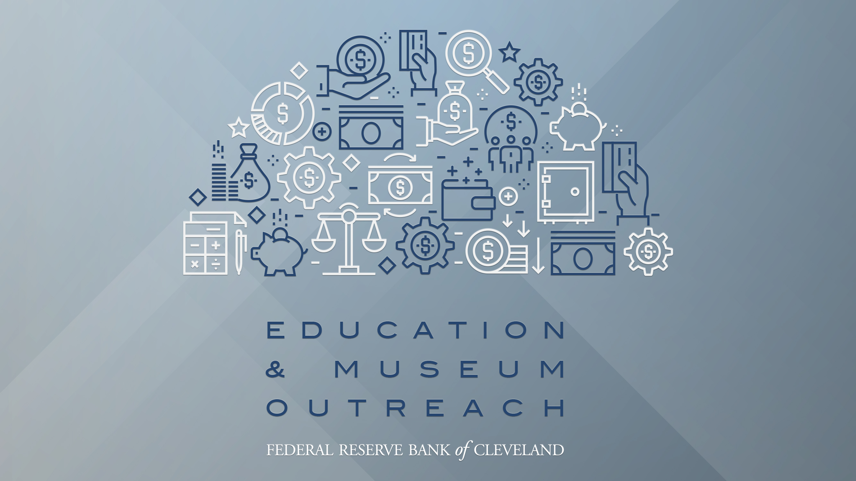

Slide 2
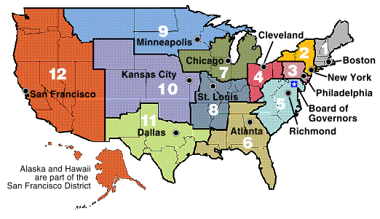
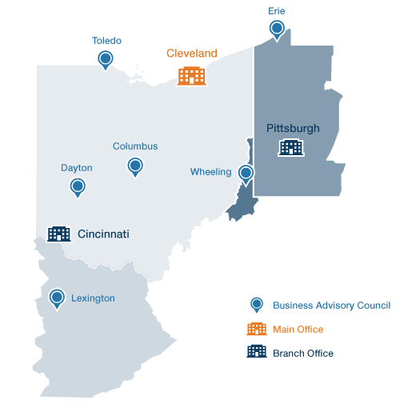
The Federal Reserve System

Slide 3
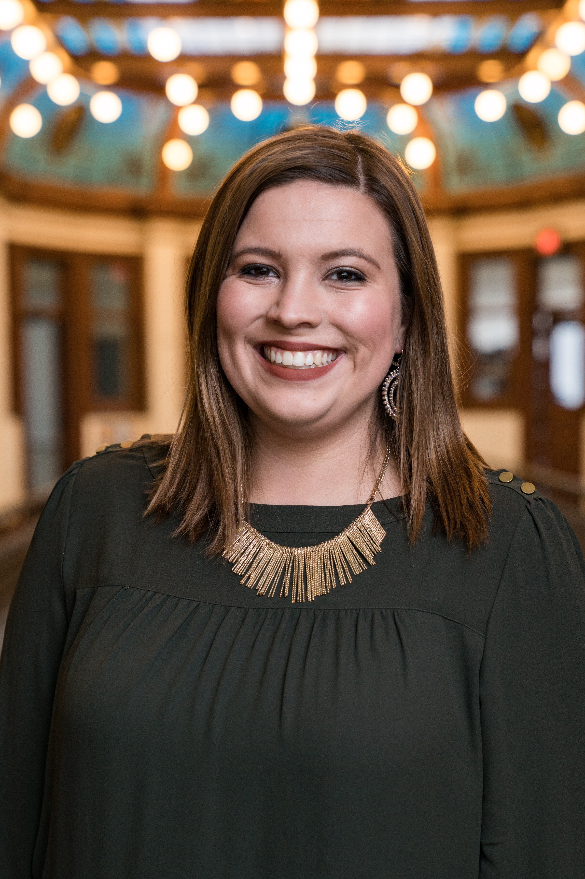
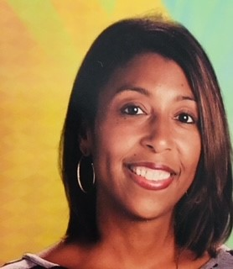
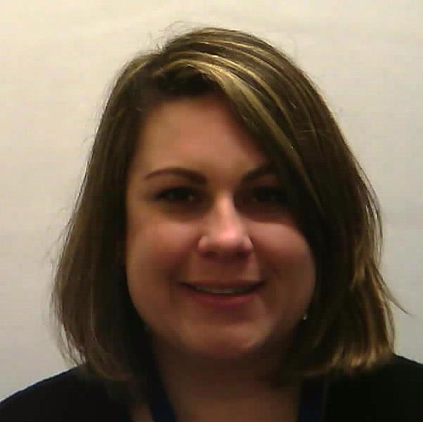
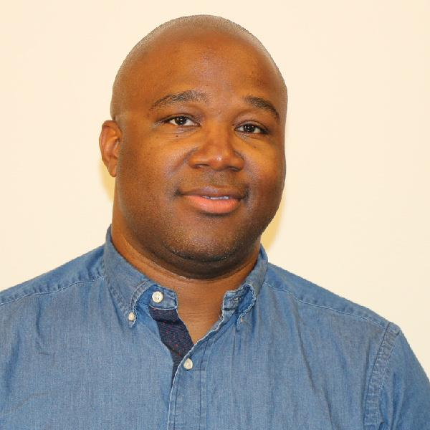
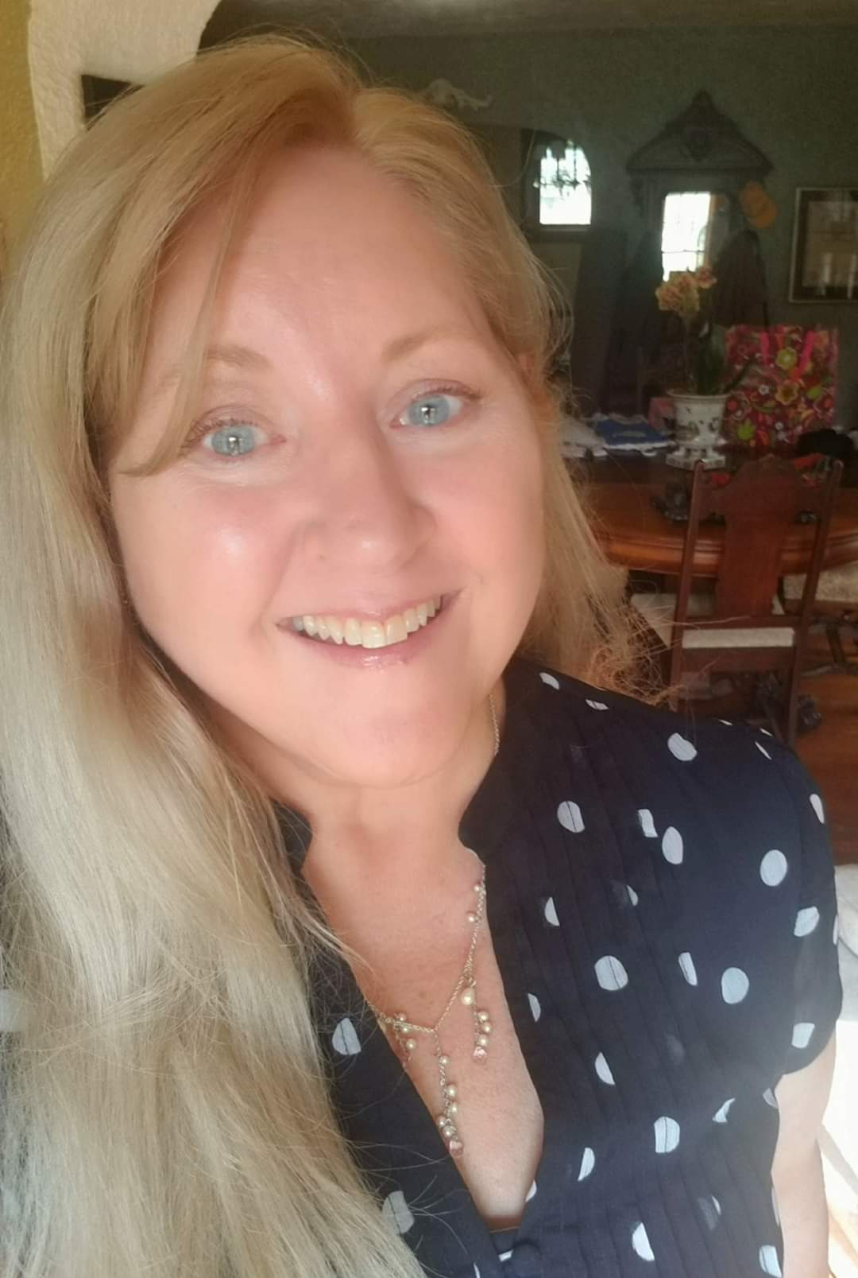
Meet the Team!
Lakisha Higgins
Eastern KY and Southern Ohio
Developing an Employable You
Elle Benak
Northeast Ohio
You Make IT Better
Alexandria Halmbacher
Central Ohio and Western PA
Danny Dollar Academy
Economic Scholars Program
Khaz Finley
Cleveland and Central Ohio
What’s Next?
Fed Futures
Robin Gavan
Northwest Ohio
Career Exploration Series

Slide 4
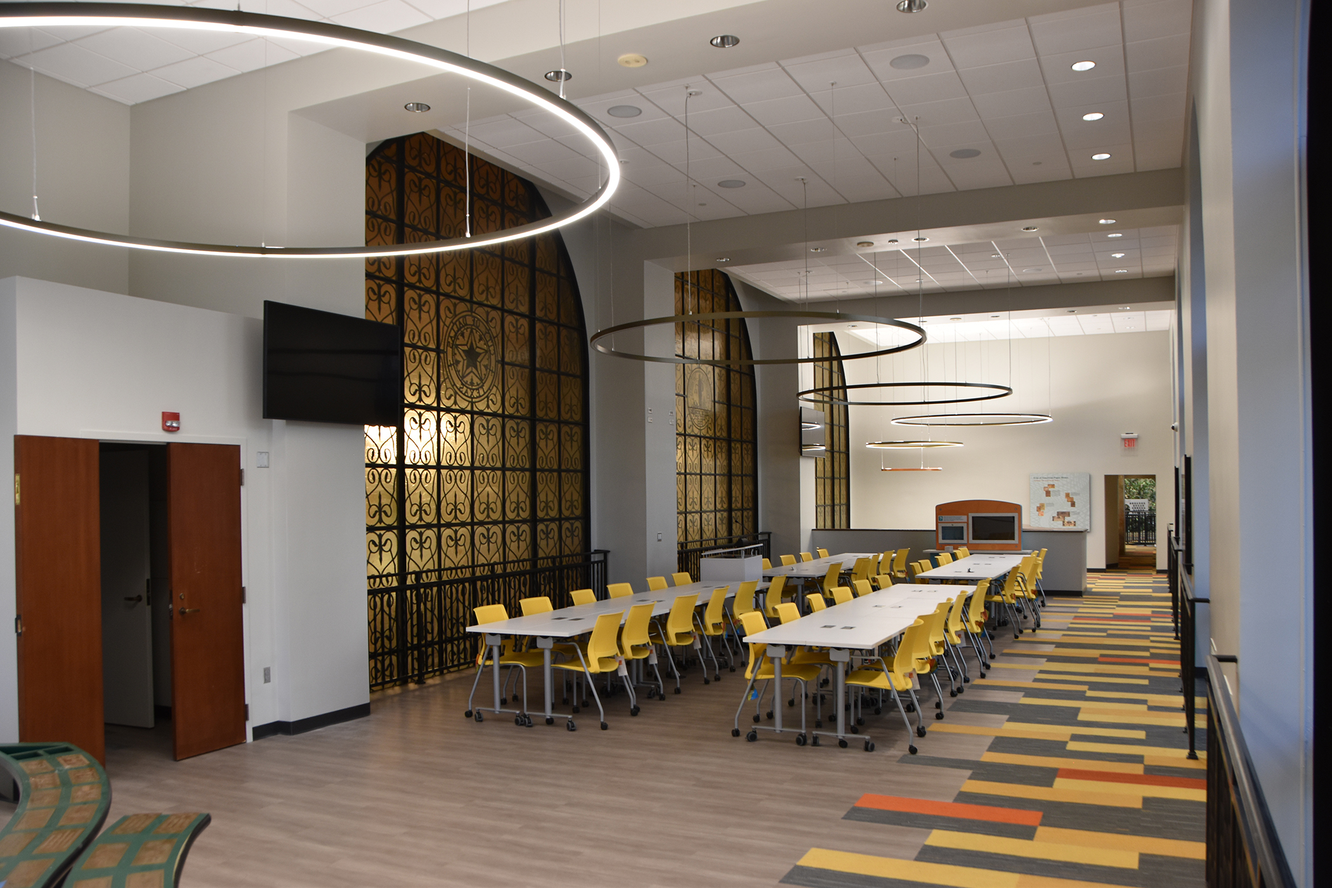
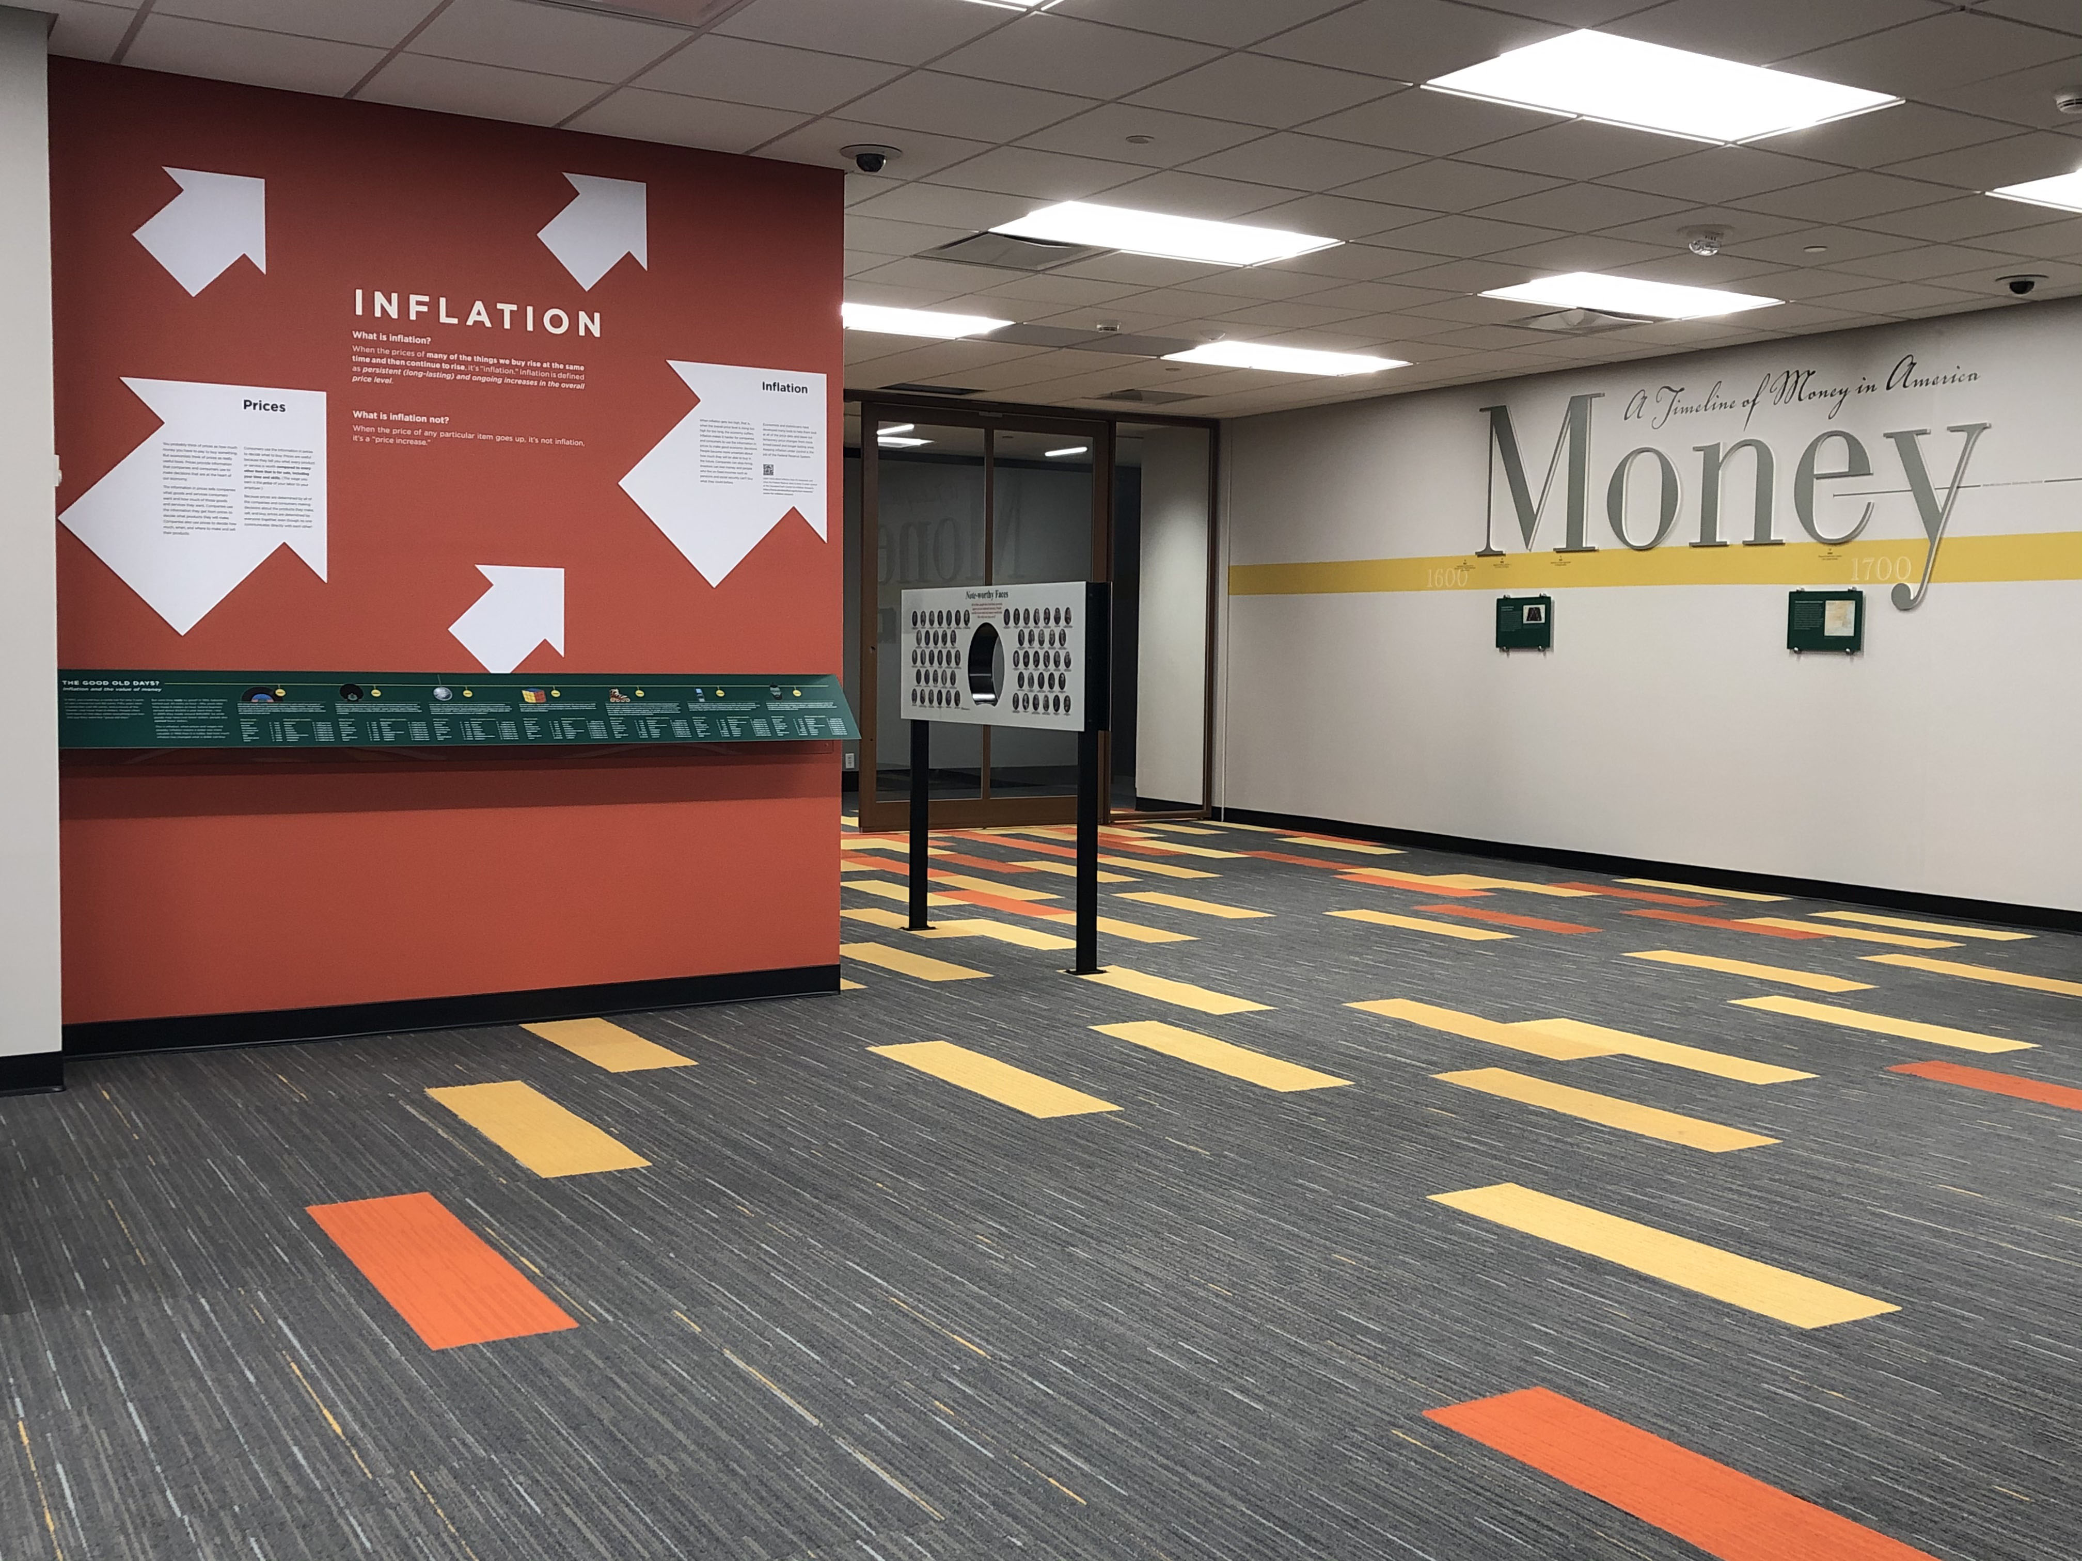
Resources
Cleveland Money Museum
  Virtual Tours: School
  Schedule
Cincinnati Learning Center
  Virtual Tours: School
  Schedule

Slide 5
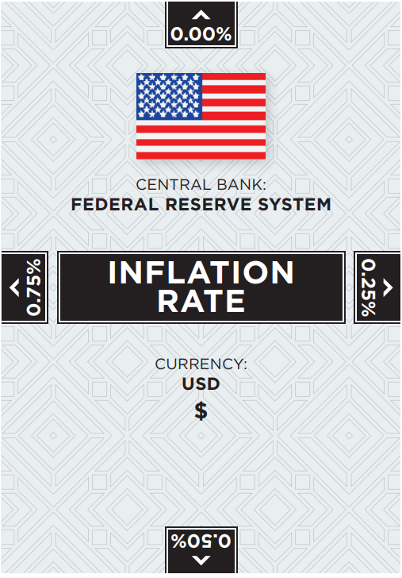
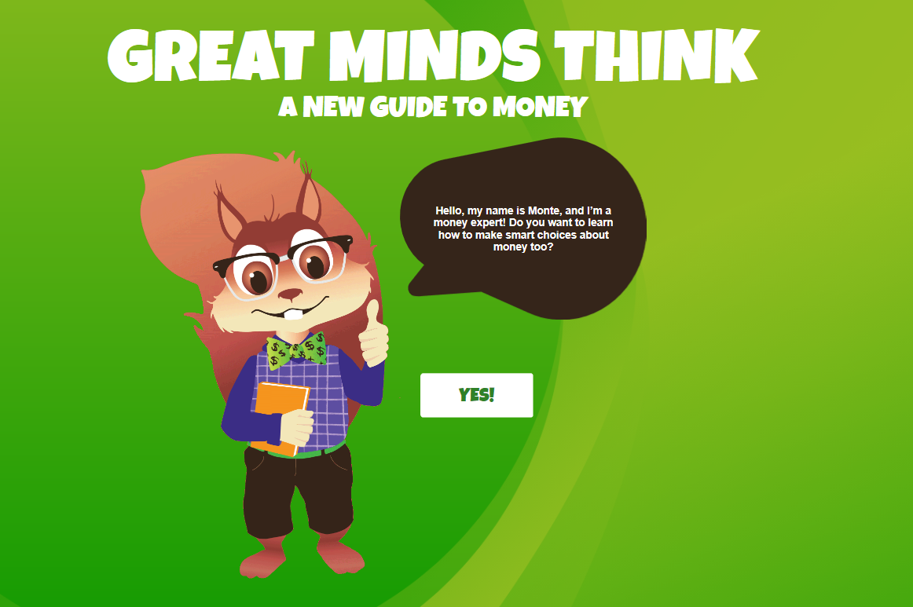

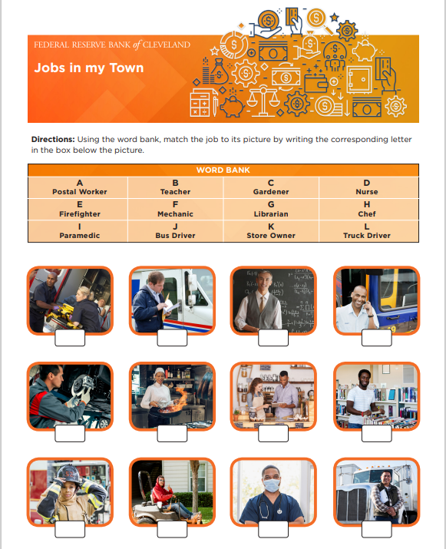
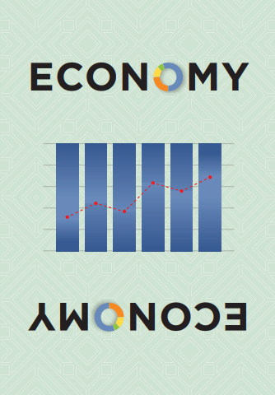

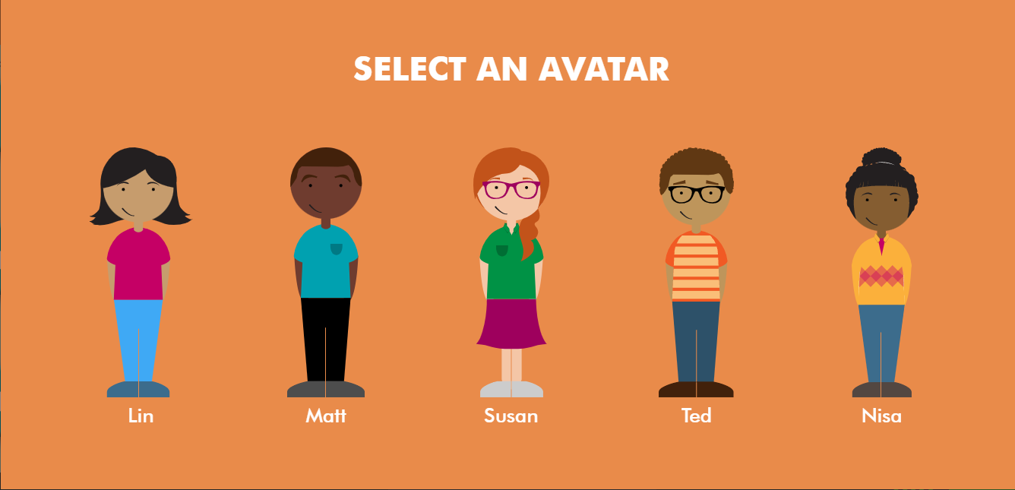

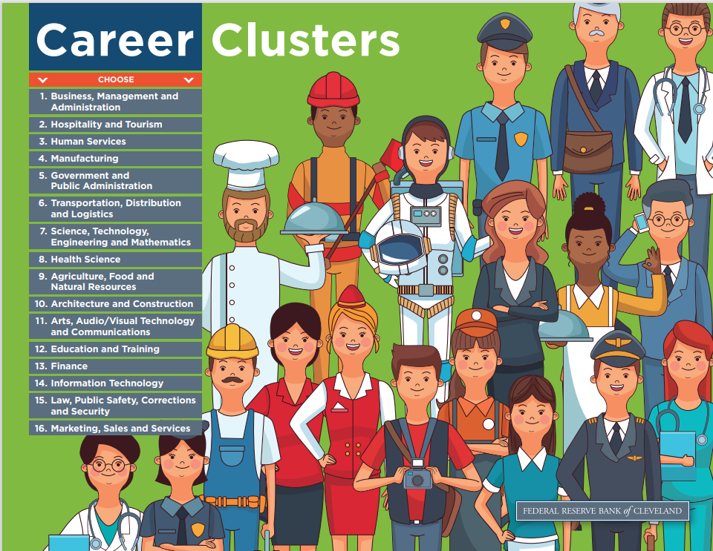
Cleveland Fed Resources

Slide 6
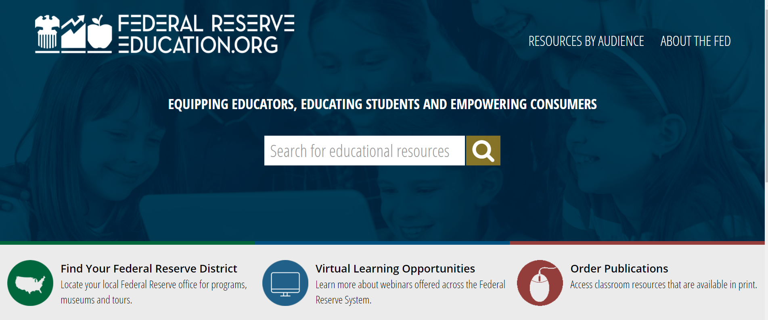
Resources from the Federal Reserve System​
Access FREE Resources from: ​
  12 Federal Reserve Banks​
  Board of Governors​
Order Classroom Resources​
Search by: ​
  Subject​
  Resource Type​
  Grade Level ​

Slide 7


Slide 8

Career Exploration Series
A personal finance and career exploration program for students in grades 6-8 to learn about budgeting, saving, investing and more. Students will gain awareness of career opportunities and learn how to make smart financial decisions.
6th Grade: Financial Decision Making and Budgeting
7th Grade: Inflation
8th Grade: Career Exploration

Slide 9
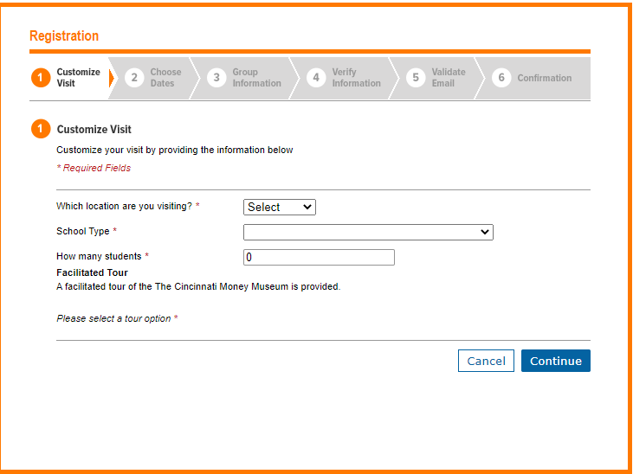
Career Exploration Series
Customize Your Visit to the Museum (clevelandmoneymuseum.org)

Slide 10

Developing an Employable You
A personal and professional development program designed to help high school students transition successfully from high school into college or a career.
  Employability Skills
  Pathways to College or a Career
  Credit Cards and Budgets
  Job Interviews, Resumes, and Cover Letters
  Paychecks and Taxes
  FAFSA Process

Slide 11
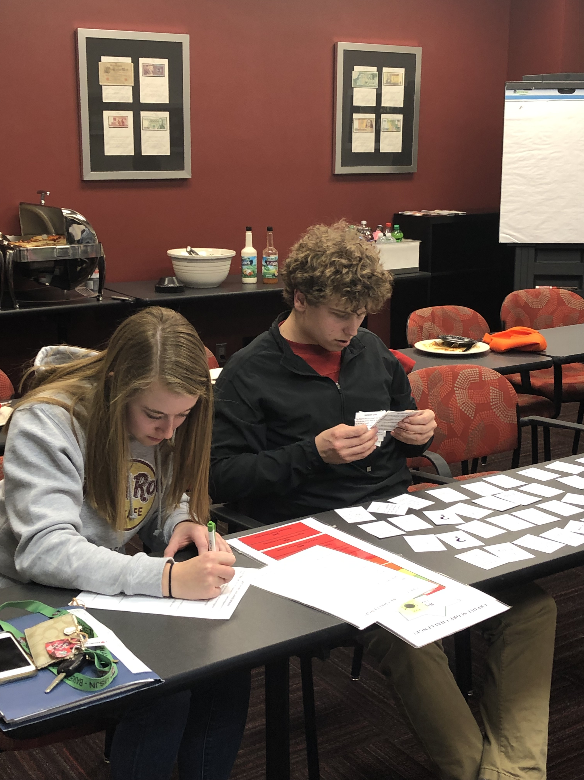
Developing an Employable You
Participating Ohio residents have the opportunity to earn credit towards the Ohio Means Jobs Readiness Seal.
November 2021-April 2022. Meets twice a month from 3-4pm virtually.
Application deadline is October 14th
Developing an Employable You 2021-2022 (cvent.com)

Slide 12

You Make IT Better
Invites high school students to explore careers in information technology and STEM through hands-on skill building activities and job-shadowing experiences with employees in STEM professions at the Cleveland Fed.
11 sessions that run October 2021 –April 2022
Job shadowing experiences will be coordinated separately throughout the duration of the program.

Slide 13
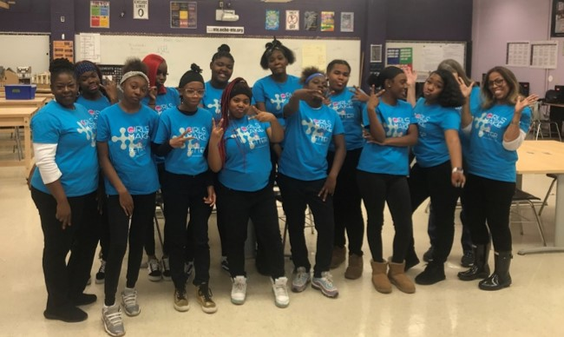
You Make IT Better
Each session includes:
A STEM mentor’s career journey
An interactive hands-on virtual activity (guided by STEM professionals)
Live Q&A session with mentor
Application deadline is October 19th
You Make I.T. Better 2021/2022 (cvent.com)

Slide 14

What’s Next? Exploring Alternative Career Options
Invites high school students to learn about the Cleveland Fed’s operational functions (Cash, Real Estate Services Group, and Law Enforcement Unit) through mentorship and job shadowing opportunities with Bank employees.
10 sessions that run October 2021 –April 2022
Job shadowing experiences will be coordinated separately throughout the duration of the program.

Slide 15
What’s Next? Exploring Alternative Career Options
Each session includes:
A mentor’s career journey
An interactive hands-on virtual activity (focused on career building skills)
Live Q&A session with mentor
Application deadline is October 15th
What's Next: Exploring Alternative Options 2021-2022 (cvent.com)

Slide 16

Fed Futures
A professional program geared towards high school students aimed at developing their interest in the economics and finance industries. Throughout the program students attend hands-on training sessions that cover a variety of career readiness and personal finance topics. Additionally, they are provided opportunities for job shadowing experiences and paid internships.

Slide 17

Economic Scholars Program
A free economic research conference that invites student scholars and faculty to come together and share undergraduate student-initiated or student coauthored works, cultivate imaginative research, gain valuable experience presenting at a professional conference, learn about internship and employment opportunities with the Federal Reserve and network with peers.

Slide 18
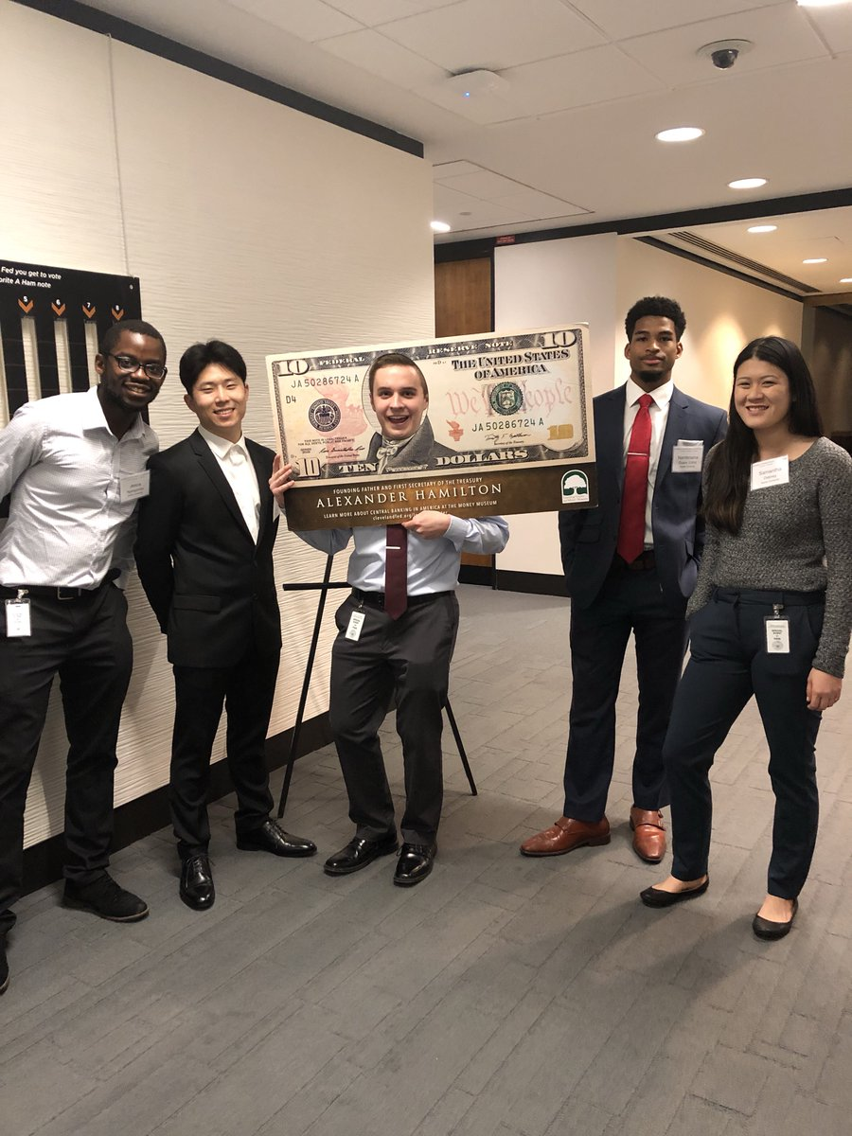
Economic Scholars Program
To learn more about attend an info session:
October 12, 4-4:30pm
The hybrid ESP conference will be help April 2022
Economics Scholars Program Session 3 (cvent.com)

Slide 19
Q & A
Alexandria Halmbacher
Alexandria.Halmbacher@clev.frb.org
Central Ohio and Western PA
Danny Dollar Academy
Economic Scholars Program
Khaz Finley
Khaz.Finley@clev.frb.org
Central Ohio and Cleveland
What’s Next? Exploring Alternative Career Options
Fed Futures
Lakisha Higgins
Lakisha.Higgins@clev.frb.org
Southern Ohio and Eastern KY
Developing an Employable You
Robin Gavan
Robin.Gavan@clev.frb.org
Northwest Ohio
Career Exploration Series
Elle Benak
Elle.Benak@clev.frb.org
Northeast Ohio
You Make IT Better

