Slide 1

Supporting Student Learning During School Closures
Mark Yoho

Slide 2
Agenda:
(20 mins)
COVID-19 Communication
2020 AP Exam Q&A
Virtual Support Resources
  AP Classroom
    Foundations and Quick Start videos
    Personal Progress Checks
    AP Question Bank
    AP Secure Practice Exam
  AP Classes
    Daily Lessons
    Lessons for every course*
    Recorded and available on demand
  Live AP Review Lessons
    Via the AP YouTube channel
Next Steps

Slide 3
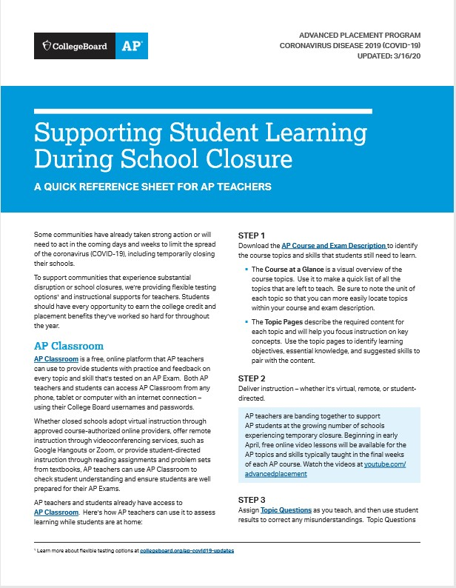
COVID-19
Communication
3
As schools and communities navigate the unprecedented challenges posed by the coronavirus (COVID-19) outbreak, the health and safety of educators and students are the AP Program’s top priorities.
Here’s how we’re supporting schools:
  We’re providing free remote learning resources.
  We’re investing in the development of a new at- home testing option.
Students should have every opportunity to earn the college credit and placement benefits they’ve worked so hard for throughout the year.
E-Quick Reference Sheet

Slide 4
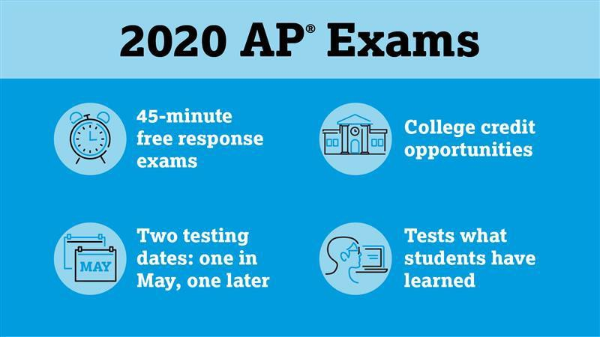
Frequently Asked Questions
4
myap.collegeboard.org
2020 AP Exam Schedule
  Live on website
Fees
  We are waiving all fees for unused/canceled exams this year.
Accommodations
  Details will be shared closer to the exam.
Independent/Self-study students
Any student who is registered to take the exam will be able to test.
The exam will only include topics and skills most AP teachers already
covered in class by early March.
Student Access to Remote AP Learning and Assessments Survey: https://collegeboard.tfaforms.net/74

Slide 5
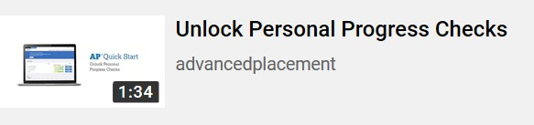
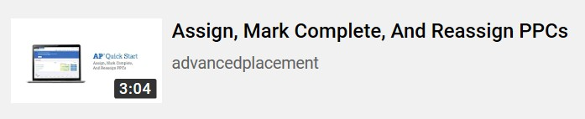
5
AP Classroom
myap.collegeboard.org
AP teachers can access these resources to help them get set up with AP Classroom:
  Foundations. Learn how AP Classroom complements the new AP course and exam descriptions and offers students opportunities for practice and feedback throughout the year.
    ~1 hour in duration.
  AP Classroom Demo. See a click-through demonstration of AP Classroom, which highlights how to assign, score, and interpret results from Topic Questions, Personal Progress Checks, and teacher-created assignments and quizzes from the AP Question Bank.
    ~1 hour in duration.
  AP Quick Start Videos. Watch short tutorials on the recent features added to AP Classroom.
    Short ~1-4 min. how-to videos.
How-to videos on AP Classroom.

Slide 6
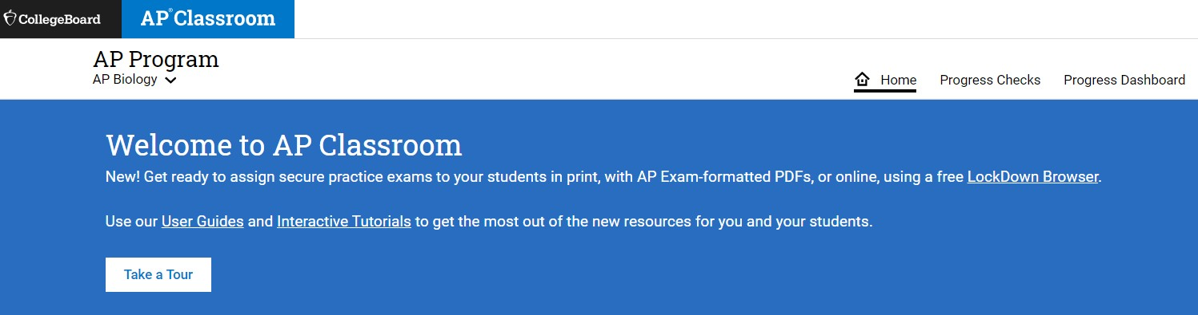

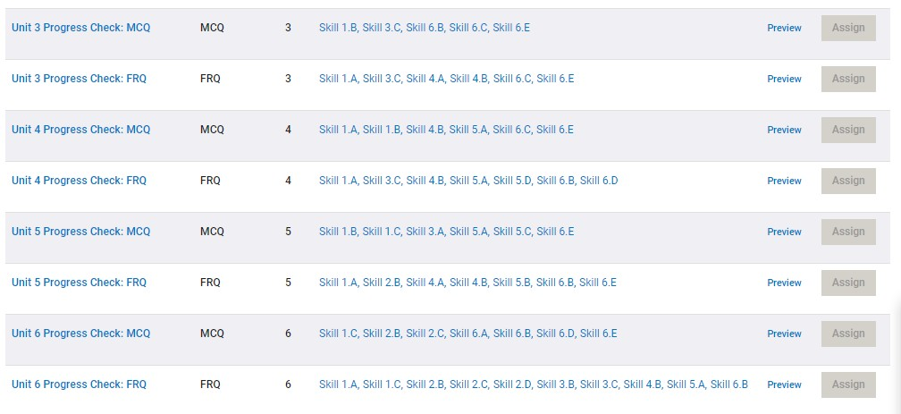

AP Classroom
6
myap.collegeboard.org
Overview Videos
Interactive Tutorials
Personal Progress Checks
AP Question Bank

Slide 7
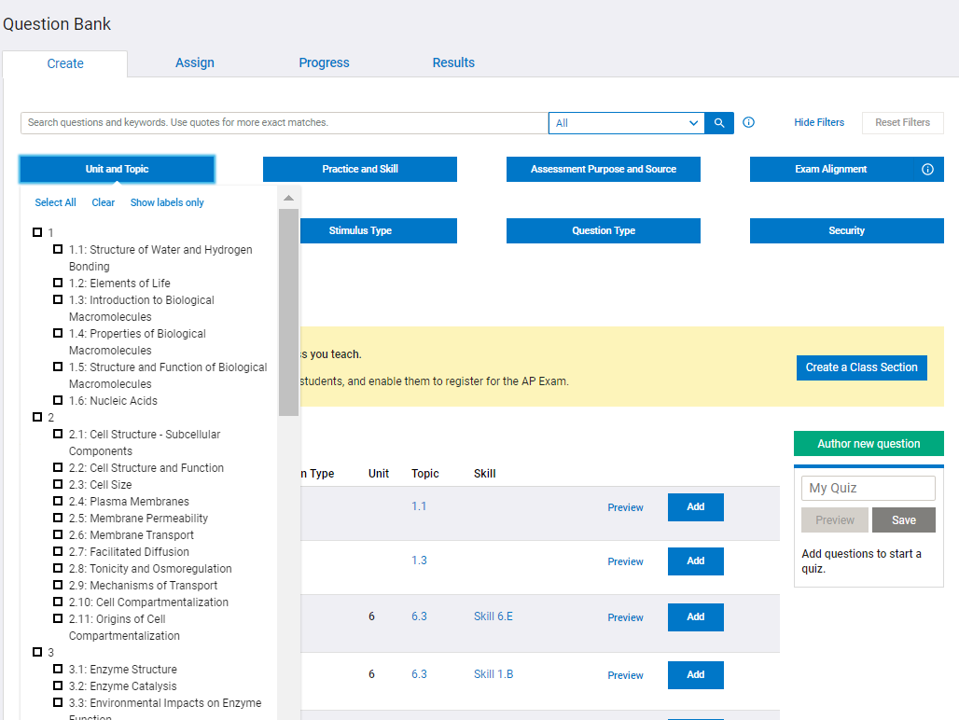

AP Classroom
7
myap.collegeboard.org
AP Question Bank
  Within AP Classroom, free- response questions that were only available for in classroom use due to security concerns will now be unlocked.
  Teachers will be able to assign questions to students digitally.

Slide 8
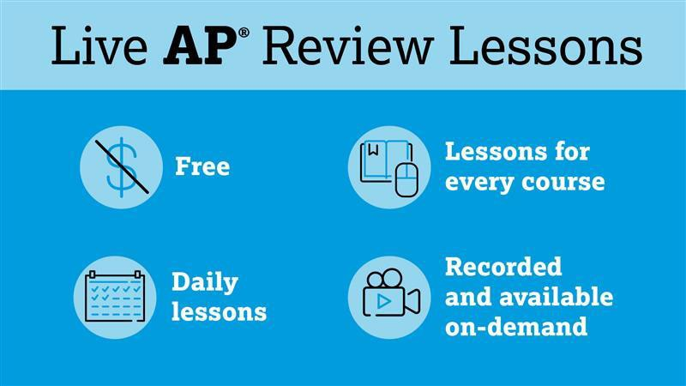
Live AP Review Lessons
8
www.youtube.com/advancedplacement
Delivered by AP teachers from across the country.
Optional, mobile-friendly, and can be used alongside teacher lessons.
Will focus on reviewing the skills and concepts from the first 75% of the course.
There will also be supplementary lessons covering the final 25% of the course.
Course schedule available.

Slide 9

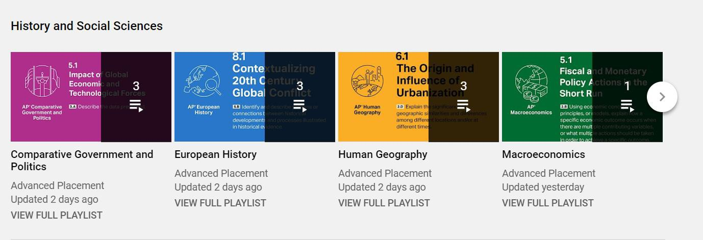
10
AP Classes
www.youtube.com/advancedplacement

Slide 10
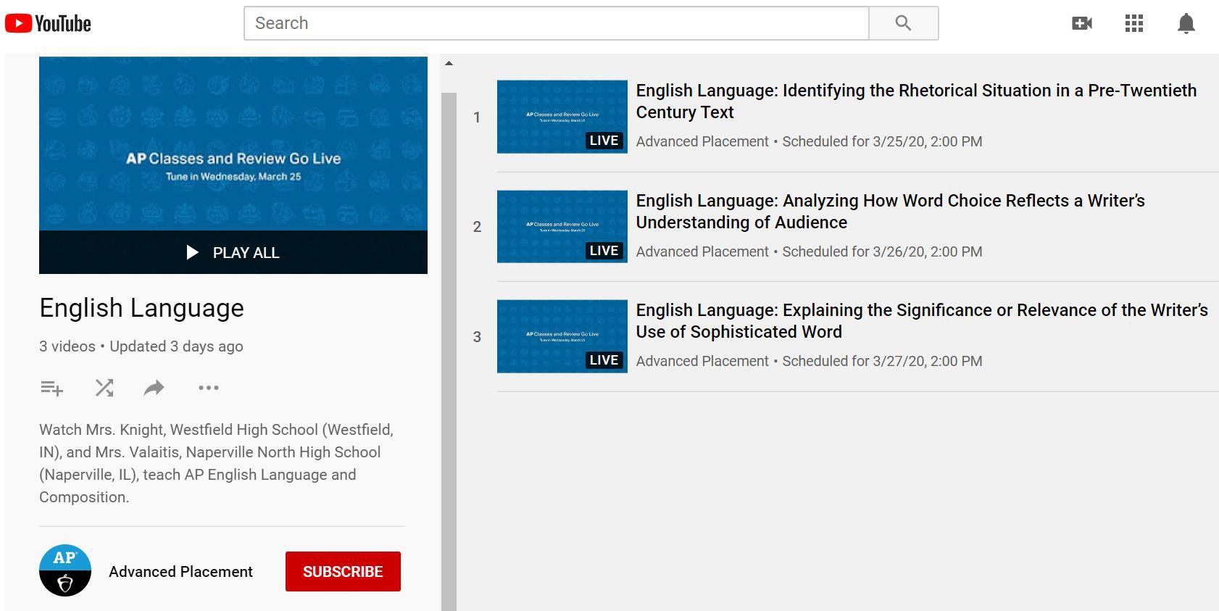
AP Classes
11
www.youtube.com/advancedplacement
Lessons are aligned to the Course and Exam Description:
Supplementary lessons covering the final 25% of the course.
Review lessons covering the first 75% of the course.

Slide 11
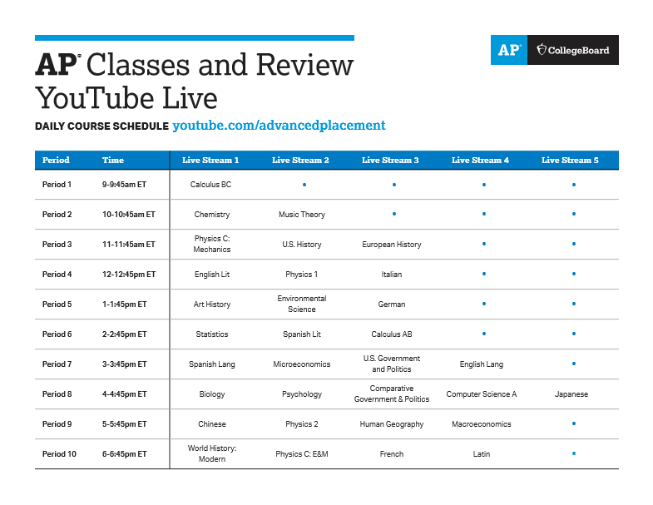
Daily Course Schedule
9
Live from 8am-5:45pm CST!
Live lessons will include embedded practice for students.
However, teachers can assign targeted practice assessments to students via AP Classroom (PPC or AP Question Bank).

Slide 12
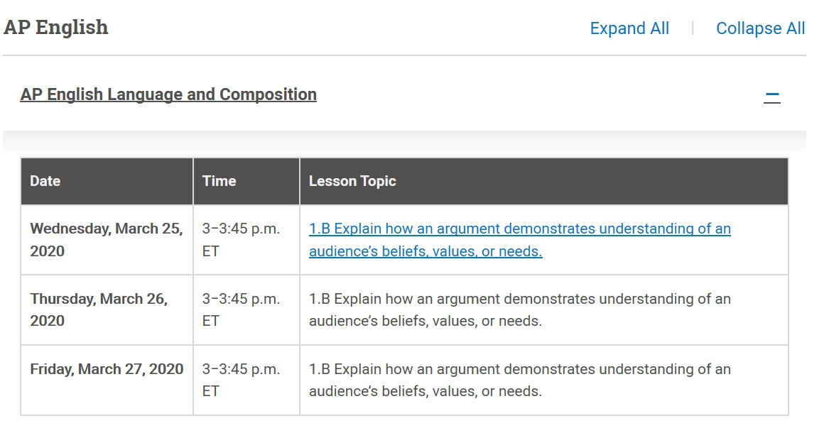
Daily Schedules
12
www.youtube.com/advancedplacement
Daily course schedule available.
Students can sign up and set reminders.

Slide 13
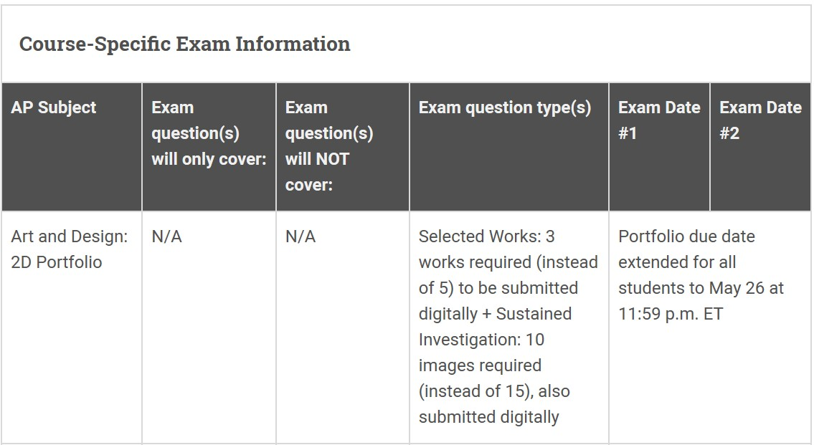
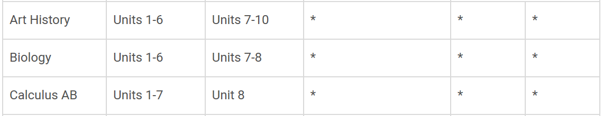
Course-Specific Exam Information
13
For course-specific questions, AP teachers can pose question(s) to the AP Teacher Community.
For AP Classroom questions, AP teachers can contact us under the Help dropdown on the AP Classroom homepage.

Slide 14
14
Next Steps
www.collegeboard.org/ap-covid19- updates
•
AP Coordinator(s):
Identify students who quality for low-income subsidy.
  https://apcentral.collegeboard.org/ap-coordinators/exam-
ordering-fees/exam-fees/federal-state-assistance
Deadline to indicate students’ fee reduction status: April 30th.
•
AP Teacher(s):
Utilize AP Classroom and the new live AP lessons to complement e- learning instruction.
Pose all content-related question(s) to subject-specific AP Teacher
Community.
•
Instructional Leader(s):
Leverage the resources in AP Classroom and/or live AP lessons.
Guide for School Leaders: Checks for Student Understanding
•
AP Administrator AP Classroom View-only Access:
The purpose of this access is to enable administrators to see how AP resources are being used by teachers and students, so they can support and guide educators.
•
AP District AP Classroom View-only Access
Access code must be requested. District staff can view a specific school/teacher/course section for AP Classroom usage.

