Slide 1
Business Advisory Council
Welcome!
We will begin our meeting in just a few minutes.
Notes:
Christine will open with first two slides

Slide 2
Today’s Agenda
Welcome
Federal Reserve Bank of Cleveland: Education and Museum Outreach
YEP (Young Entrepreneurs Program)
Jesus Garcia Fuentes, Executive Director of YEP Columbus
Parent & Community Engagement
Survey Update & Next Steps

Slide 3
Alexandria Halmbacher
Central Ohio and Western PA
Danny Dollar Academy
Economic Scholars Program
Khaz Finley
Cleveland and Central Ohio
What’s Next?
Fed Futures

Slide 4
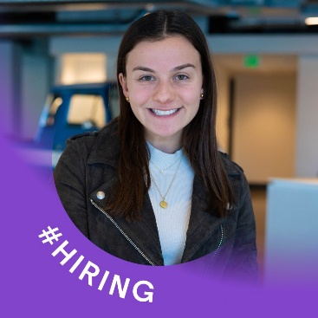
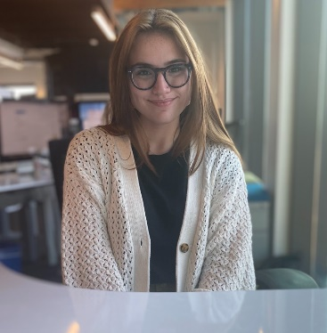
Jesus Garcia Fuentes,
Executive Director, Columbus
Olivia Weinstock
CEO and Co-Founder
Tandem Inc
Aaliyah Barker
(YEP class of 2021)
YEP (Young Entrepreneurs Program) is a hands-on summer internship program for high school students that focuses on entrepreneurial thinking and development through practical experience. The working experience and exposure each student will acquire during their time with YEP makes this an internship program unlike any other.
Jesus Garcia Fuentes,
Executive Director, Columbus
jfuentes@yepkc.org

Slide 5
Parent & Community Awareness Workgroup Students in Ohio have many pathways to be successful in school and be prepared for the future.
https://www.escco.org/BACParentCommunityAwareness.aspx
Parent Conversations – Coffee Talks/Columbus State Events
Resources – Websites, articles, videos
Brainstorm Media – Video series highlighting local employers
Social Media Campaign- Promote awareness for families
New Vision Media – Video series highlighting career exploration, engagement & experience

Slide 6
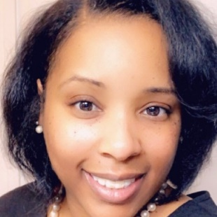
Parent & Community Awareness Workgroup Students in Ohio have many pathways to be successful in school and be prepared for the future.
Kimberly Connell Director of Readiness and College Transitions Columbus State Community College
A-Jay Orr
Author, Veteran and
CEO of Simple Plan IT

Slide 7
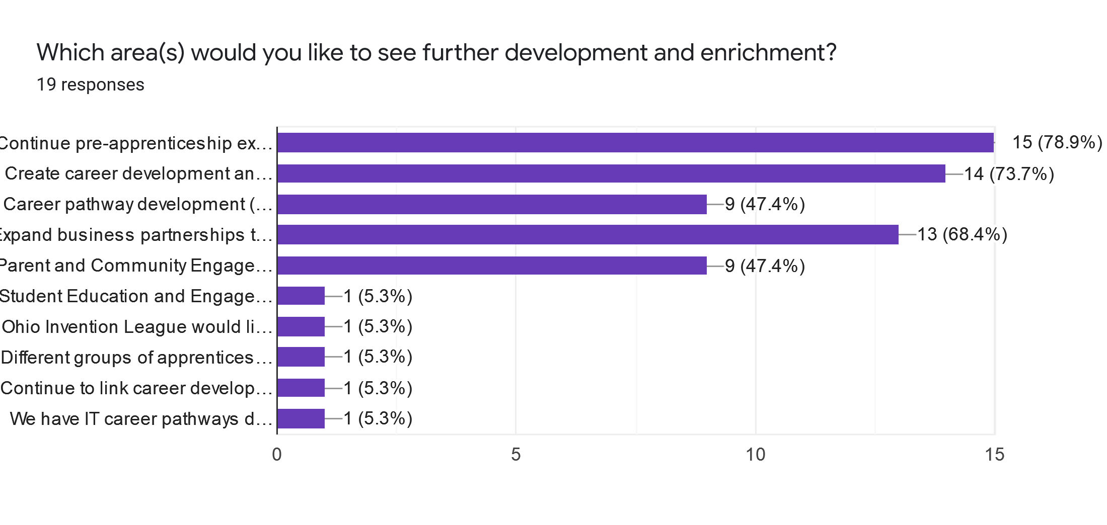
Where should we go next?
Continue pre-apprenticeship expansion and linkage to apprenticeship programs
Create career development and work-based learning experiences
Expand business partnerships throughout Central Ohio
Career pathway development ( IT, healthcare, EMT, Office and Business as examples)
Parent and Community Engagement

Slide 8
Work-based Learning
Continuing to build out Pre-Apprenticeships
22 Recognized Pre-Apprenticeships
13 Schools
Identifying and developing career development and work-based learning experiences
Expand business partnerships throughout Central Ohio
•Develop Awareness
•Create Outreach
•Build Relationships
•Inform and Collaborate

Slide 9
Call to Action
I pledge to do one or more of the following actions:
Work to expand business and district partnerships
Identify and create career development and work-based learning experiences
Participate in development of pathways and career exploration experiences
Participate in the Work-based Learning work group
Participate in the Parent & Community Engagement work group
Call to Action: https://forms.gle/KBud9sFjLfeSthe57

Slide 10
Contact Information
Christine Galvin
Director of College and Career Success
Christine.Galvin@escco.org
John Hambrick
Work-Based Learning Coordinator
John.Hambrick@escco.org
Doug Levy
Project Manager
Douglas.Levy@escco.org

