Slide 1
From Remote to Reality: Transitioning Back to School
Bryant Tela, MSE, MSW, LSW
Specialized On-Site/Online Support (SOS) Team
Our Mission: Build professional capacity to improve outcomes for all students utilizing an expert multi-disciplinary approach

Slide 2


Slide 3
SOS Team
Specialized On-Site/Online Support (SOS) Team
Our Mission: Build professional capacity to improve outcomes for all students utilizing an expert multi-disciplinary approach
Behavior Intervention/ Mental Health Consultant

Slide 4
Acknowledgement
Content and Information for this presentation is based on resources from the following:
CASEL-Collaborative for Social Emotional Learning
IIRP- International Institute for Restorative Practices
Mid-West PBIS

Slide 5
Plan for our time
Define Stress- what it is, how it is, what can we do
Discuss our experiences during our working remotely
Develop a plan for Self-Care that will lead to We Care

Slide 6
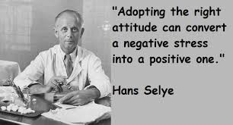
Defining Stress
Term stress coined in early 1930s
“Non-specific response to any demand”
Stress is different for everyone
Stress is not always bad
The American Institute of Stress https://www.stress.org/what-is-stress
Notes:
The term stress was actually coin in the 1930s and our reaction to stress can be very different. Some things are more stressful and cause different reactions than for others. It is also important to remember that all stressors are not bad (i.e.: getting married, having a baby, buying a house) and that reaction to stress is also not always bad.
Big point here though is that: We do not get to decide what is stressful and what is not stressful.

Slide 7
3 Types of Stress
Positive Stress
  Normal and essential
  Brief increases in heart rate and hormone levels
Tolerable Stress
  Stress response activated to greater degree
  More severe, pro-longed
Toxic Stress
  Strong, frequent and long-lasting events
  Causes impairment (brain functioning, immune system)
https://www.ncbi.nlm.nih.gov/pmc/articles/PMC4928741/
Notes:
Examples of:
Positive stress: planning for a presentation, being evaluated, buying a house, getting married
Tolerable stress: loss of a loved one, natural disaster, divorce
Toxic stress: abuse, financial stress, mental health, chronic illness
Of course any of these examples could be different levels of stress for someone else. Because it is our response to event rather than event that defines.

Slide 8
Reflect on the following
What did you learn about yourself during our time working remotely?
Please share in the chat

Slide 9
What did you discover you needed during this time?
I discovered
I needed
I am a procrastinator
I am not as organized as I thought
I like driving
Other things…
Structure
Schedule
Connection
Movement

Slide 10
Impact of What We Experienced
Critical, Moody, Frustrated
Not solution oriented- Emotionally focused
• Strain our health and wellbeing

Slide 11
Ladder of Regulation
Needs
Empowerment
Challenge
Feelings
Engagement
Awareness
Nurture
Safety
Structure
IIRP, 2020

Slide 12
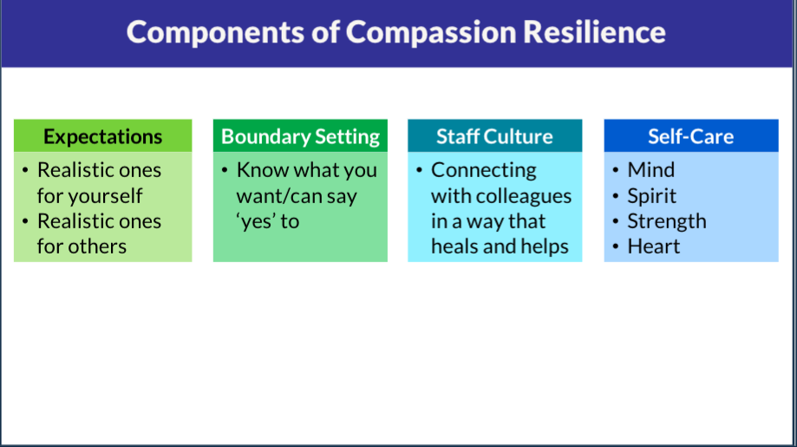
Components of Care
Wisconsin Department of Public Instruction – Trauma Sensitive Schools
Module 4: https://dpi.wi.gov/sspw/mental-health/trauma/modules
Notes:
Wisconsin Department of Public Instruction and their Trauma Sensitive Schools Project defines compassion resilience as containing four components.
Expectations: having defined and realistic expectations for self and others
Boundaries: appropriate boundary setting for both individual and system
Staff Culture: work environment and connection with colleagues
Self Care: focus on caring for oneself
While we are going to focus on self-care, we believe there is more to developing compassion resilience. A PPT to consider establishing a district or building culture for self-care is posted with Module 1 utilizing data, systems and practices.

Slide 13
What is self-care?
Self-care has been defined as providing adequate attention to one's own physical and psychological wellness
(Beauchamp & Childress, 2001).

Slide 14
Self-Care
IS NOT.....
IS.....
Selfish
A once a week thing
Spontaneous
Not the same for everyone
Not something that others need and you don’t
Responsible
Small strategies throughout the day
Scheduled
About what works for you
We all need it!!

Slide 15
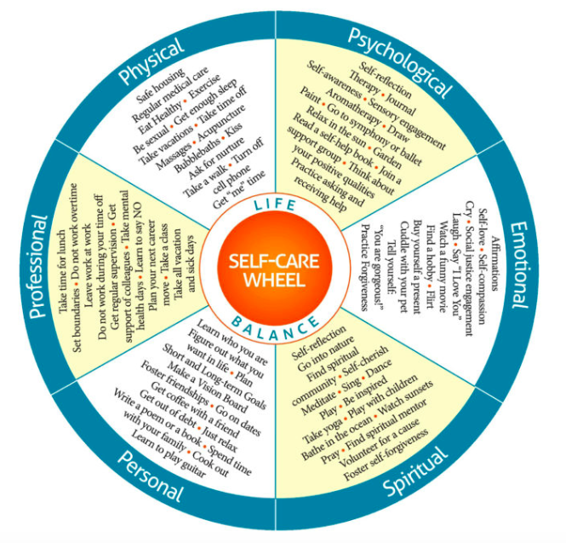
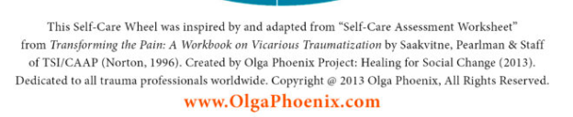
Notes:
Self-care has multiple domains. What works for one person is not always what works for someone else. Important to consider multiple domains of self-care when developing your self-care plan.

Slide 16
My Self Care Plan
Allow myself to be present:
  How much of my day is spent ‘time-traveling’ vs. being in the present moment?
Remember my values
  How can I act towards my values?
Be kind to myself
  Schedule time for self-regulation
  Do things I enjoy
  I may be unavailable to others during these times
  Mistakes are okay

Slide 17
Moving from Self-Care to We Care
Some things to consider:
What is on your mind as you think about next school year?
What are your biggest hopes or worries?
What has our school done well during the past months, and what could we have done better?

Slide 18
Moving from Self-Care to We Care
How might you like to contribute as we prepare to transition to a new school year?
What can we do to make school feel even more like a community that cares for you?
Other questions and or thoughts?

Slide 19
Focus on the Adults First
If we are dysregulated, Our students will be dysregulated
Remember what we needed to feel safe
Structure, Predictability, and Consistency
Redefine and reconnection of PBIS and SEL

Slide 20

Finally
Take time to reconnect with educators, parents, and students
Model self-care and community building
Remember what you value, live it every day

Slide 21
Final Thoughts
We must deliver self-care support in small, doable doses. Even when the dose is so small that it doesn’t appear to make a noticeable physical difference, it can still make an extraordinarily meaningful difference. There is no act of self-care that does not contribute to well-being.
(Coyne et. al, 2020)

Slide 22
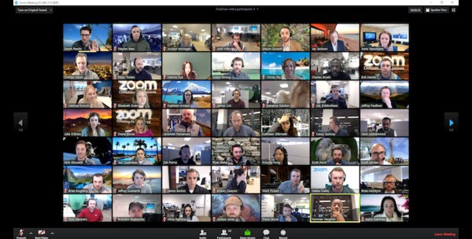
Please put one take away in the chat box before heading out

Slide 23


Slide 24
ADDITIONAL SOURCES
American Institutes for Research (AIR). (2019). Trauma-Sensitive Schools Training Package. Retrieved from: https://safesupportivelearning.ed.gov/building-trauma-sensitive-schools
Brandi Simonsen, D. M. (2015). Class-wide Positive Behavior Interventions and Supports . New York, New York, United States: The Guilford Press.
Craig, S. E. (2016). Trauma-sensitive schools: Learning communities transforming children'slives, K-5. New York, NY: Teachers College Press.
DeWitt, Peter (2011). Ed Week: What Great Educators Do Differently: A Conversation with Todd Whitaker.
Kent McIntosh, S. G. (2016). Integrated Multi-Tiered Systems of Support, Blending RTI and PBIS. New York, New York, United States of America: The Guilford Press.
OSEP Technical Assistance Center on Positive Behavioral Interventions and Supports (October 2015). Positive Behavioral Interventions and Supports (PBIS) Implementation Blueprint: Part 1 – Foundations and Supporting Information. Eugene, OR: University of Oregon. Retrieved from www.pbis.org.

Slide 25
ADDITIONAL SOURCES
Nakazawa Jackson, D. (2015). Childhood Disrupted: How Your Biography Becomes Your Biology, and How You Can Heal.
Siegel, D. J. & Bryson, T. P. (2012). The whole-brain child. New York, NY: Bantam Books Trade Paperback Edition.
Souers, K. & Hall, P. (2016). Fostering resilient learners: Strategies for creating trauma-sensitive classroom. Alexandria, VA: ASCD.
Substance Abuse and Mental Health Services Administration. SAMHSA’s Concept of Trauma and Guidance for a Trauma-Informed Approach. HHS Publication No. (SMA) 14-4884. Rockville, MD: Substance Abuse and Mental Health Services Administration, 2014
Wolpow, R., Johnson, M. M., Hertel, R., Kincaid, S. O. (May 2016).
The heart of learning and teaching: Compassion, resiliency, and academic success. Washing State Office of Superintendent of Public Instruction.

