Slide 1
Partnerships for Equal Opportunities
Kayla Mack, Michelle Washington, Barb Dunlap ∙ 02/10/2022

Slide 2
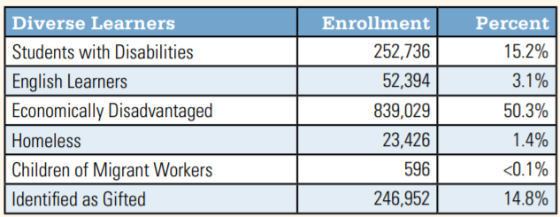
Background
Background
The Ohio Department of Education’s Office of Graduate Success is on a mission to optimize business partnerships and opportunities for underserved students by establishing state level partnerships to enable local action.
Each Child, Our Future is Ohio’s shared plan for ensuring that each student is challenged, prepared and empowered for his or her future by way of an excellent prekindergarten through grade 12 (preK-12) education.
51% of Ohio’s total student population is considered economically disadvantaged, an increase of 37 percent in 10 years.
Notes:
Michelle

Slide 3
Past Meetup Highlights
Data
Mapping Student Success
Funded Programming Opportunity
Notes:
Kayla
During the September Kick Off Meeting we talked about the educational landscape of underserved student populations and how creating opportunities for students to experience and explore career options early, creates space for them to have a greater idea of what they want to pursue, establish opportunities to attend post-secondary programs that are employer funded, specialized and relevant to their goals. Additionally, when students experience and explore career options early it provides a clearer vision of what is truly needed to secure a livable wage in the career field of their choice, as it may not be a 4-year degree but rather a credentialing program or certification that can be completed in 2 years or less and more so while in high school through career technical education programming, internships, and pre-apprenticeships.
Barbara Dunlap, Coordinator for AEP Transmission Co-op and Internship program shared from a business lens, the purpose, process, and payoff in establishing a high school workforce program. In addition, from the Workforce Development Board of Central Ohio, Stephanie Robinson Director of Policy and Initiatives and Lawrence Jackson, Grants and Program Manager shared of their community-based partnerships and programs such as the Comprehensive Case Management and Employment Program (CCMEP or known is Central Ohio as A.M.P) the workforce development board is spearheading to support Central Ohio youth in both being prepared and focused on “their next”

Slide 4
Exploring the why
Notes:
Michelle

Slide 5
Barbara Dunlap Coordinator for AEP Transmission Co-op and Internship Program
Notes:
Barbara Dunlap is the Coordinator for the AEP Transmission Co-op and Internship Program and responsible for building a pipeline of talent focused on the newest generation of engineers.
Through on-campus engagements with organizations like IEEE, NSBE, SWE, SHPE, and SASE, Ms. Dunlap is tasked with strengthening strategic relationships, developing retention strategies, and expanding engagement programs for K-12 schools that will assist with building talent for the future of energy. In addition, she serves on the executive boards of the National Society of Black Engineers (NSBE), one of the largest student-governed organizations based in the United States.
Prior to taking her current role with the AEP Transmission Business Operations department in 2017, Ms. Dunlap was a Transmission Line Engineer with American Electric Power for 11 years and the single point of contact for the public utility and transportation relocation projects.
Barbara proudly hails from Cleveland, Ohio with strong ties to West Point, Mississippi. Armed with a Bachelor of Science degree in Construction Engineering Technology from the University of Toledo and a MBA with a focus on Leadership from Franklin University in Columbus, Ohio. Barbara is honored to be a Spring 2022 doctoral candidate at Ashland University. She plans to change the world by applying research to develop effective, evidence-informed solutions.

Slide 6
High School Internship Cost Benefit
A study by the National Association of Colleges and Employers found that almost 40% of employers reported a higher five-year retention rate among employees they hired from their paid internship programs
Employers save $15,000 in training, hiring, and turnover costs for each employee they hire from their intern pool
(Source: Management Review)
10-week full-time intern costs employers around $3,000 (Source: https://www.findspark.com/why-employers-benefit-from-paying-interns/)
U.S. Department of Labor, states the cost of a bad hire can equal up to 30% of the individual's first-year potential earnings. In other words, ONE bad hire with an annual income of $50,000 can cost an employer up to $15,000 (Source: https://www.selectonellc.com/blog/internships-are-the-secret-to-cutting-costs)

Slide 7
High School Internship Cost Benefit
SHRM Survey
Exempt positions are at $6,943 Cost Per Hire
Non-exempt positions are reported at $2,546 per hire.
And cost per hire for high skills range from $9,777 to $19,219.
Companies typically spend $10,000 - $50,000 in tangible costs alone to replace and retrain when a single employee leaves the company
81% of employers find new hires with relevant internship experience are better prepared for the workforce than those without internship experience
(Source: https://www.selectonellc.com/blog/internships-are-the-secret-to-cutting-costs)

Slide 8
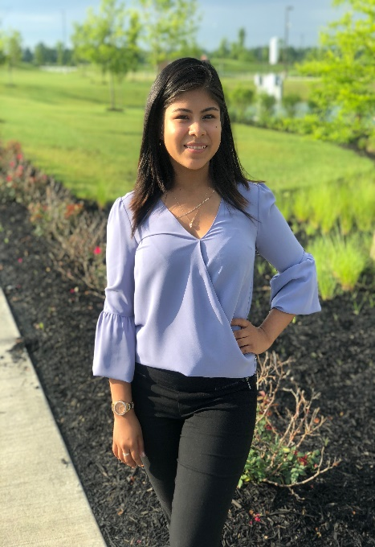
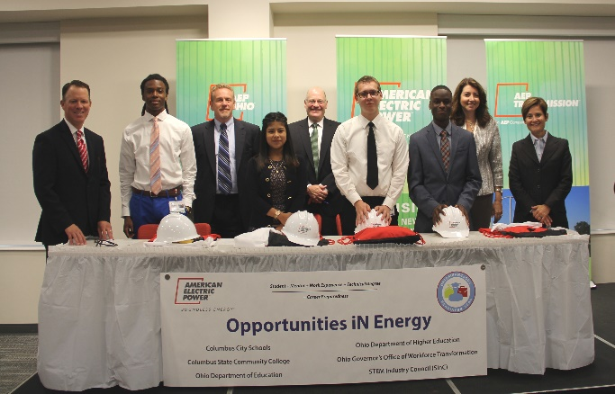
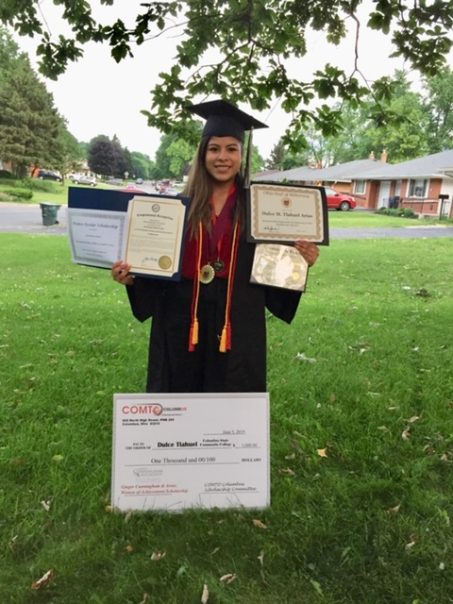
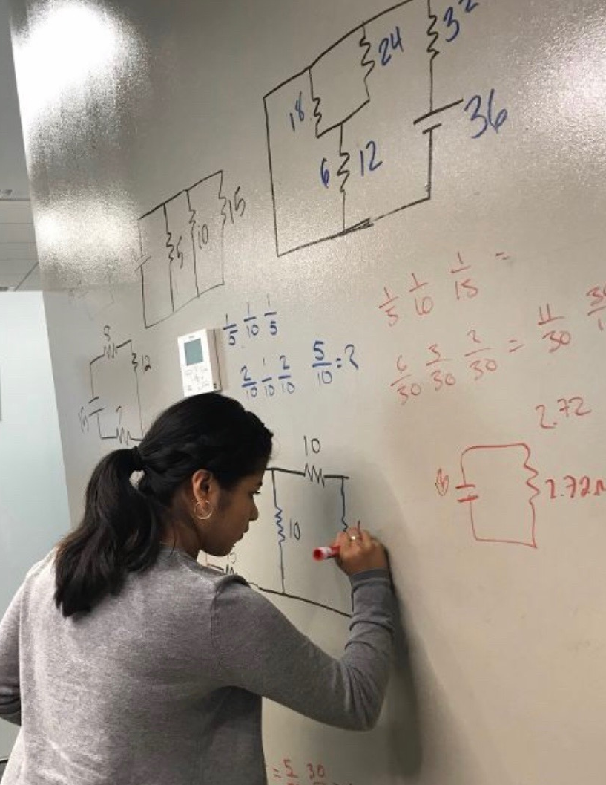
Meet Dulce!!
Dulce was one of four HS students to intern in first rotation
Graduated from Columbus City Schools
First in her family to attend college
Current major Electro-mechanical engineering technology at Columbus State Community College
Enrolled in TFS Power Tech Program
Currently taking a summer classes at CSCC
Planning to graduate at the end of summer of 2021 .
Plans for the Future – Become FTE AEP and take advantage of Miami of Ohio in partnership with Columbus State where they have the live classes from Miami University at Columbus State in the evenings
Major at Miami will remain the same Electro-mechanical engineering technology

Slide 9
Jamboard

Slide 10
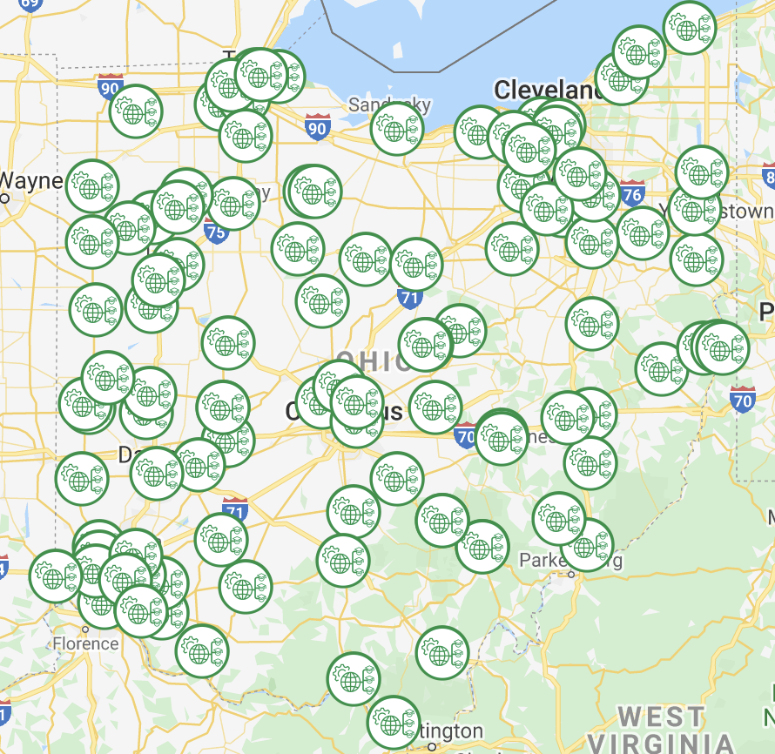
Business Advisory Councils
Where are the gaps and opportunities on your council?
Notes:
Michelle

Slide 11
Tapping Into Community Resources
Notes:
Michelle/Barb
https://www.nstnetwork.org/

Slide 12
Q&A

Slide 13
@OHEducation

Slide 14
Share your learning community with us!
#MyOhioClassroom
Celebrate educators!
#OhioLovesTeachers

