Slide 1


Notes:
Do welcome and protocols here

Slide 2
Today’s AGENDA
Latest Updates on Legislation/Fall Reopening Guidance
Self-Care Strategies/Resources
Tools & Resources for Fall Considerations

Slide 3
Legislative Update
June 18, 2020

Slide 4
Topics
Federal/National
State
Local

Slide 5
Federal COVID-19 Response
Coronavirus Preparedness and Response Supplemental Appropriations Act
Families First Coronavirus Response Act
Coronavirus Aid, Relief, and Economic Security Act
  $13.5B for schools
  $3B governor stabilization fund
Fourth bill relate to COVID-19?

Slide 6

Ohio Budget
$355M cut from education in FY20
  Overall budget cut of $775M
FY21 budget hole at $2.4B
FY22-23 biennial budget will likely see more cuts

Slide 7
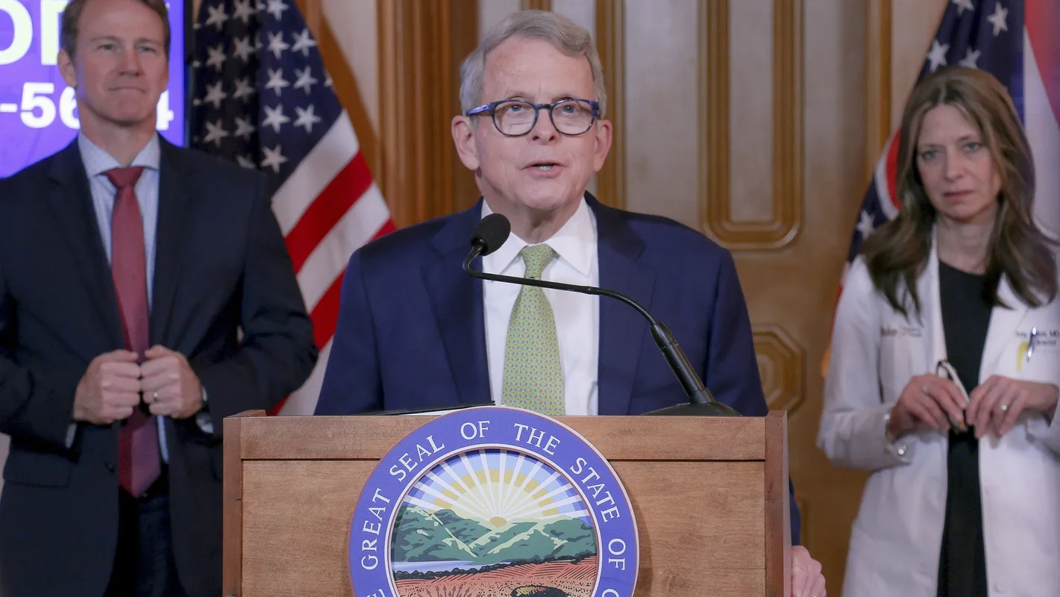
Ohio Schools 2020-2021
Schools likely to have much authority over operations for upcoming year

Slide 8
Ohio Department of Education Draft Guidance
Ensure local flexibility within state-defined parameters
Protect the health and safety of students, staff and visitors by supporting state and local efforts at controlling the spread of coronavirus
Assess students to determine where they are starting from (in the context of state standards) and determine the best path forward for each student

Slide 9
Ohio Department of Education Draft Guidance (cont.)
Support literacy, content literacy and numeracy by providing intervention opportunities, and support students in their continuing pursuit of their passions and/or career potential (music, art, other electives, industry credentials, etc.)
Ensure educator support and training to support children and families
Support social, emotional and physical health of students and staff

Slide 10
Ohio Department of Education Draft Guidance (cont.)
Prioritize the needs of the most vulnerable students including students with disabilities, low income students, English learners, homeless, foster care and justice involved youth, etc.
Create two-way communication with families and caregivers to assess students’ and families’ needs and communicate expectations and supports

Slide 11
House Bill 164
Teacher & principal evaluations
  Prohibits value-added or other growth data from being used in 20-21 evaluations
High school diplomas & end-of-course exams
  For 19-20, may use a student’s final course grade in lieu of cancelled end-of-course exam

Slide 12
House Bill 164
Third Grade Reading Guarantee
  For 20-21, prohibits retaining student in third grade that doesn’t attain passing score on fall exam, assuming principal and teacher agree
  Teachers assigned to provide intensive reading remediation for the 20-21 school year are exempt from having a reading endorsement or other mandated criteria

Slide 13
House Bill 164
Reading Improvement Plans
  Schools and districts do not have to establish reading improvement plans for the 20-21 school year based on 19-20 results
Serving Students with Special Needs
  Permits nonclassroom personnel to provide services electronically or via telehealth for 20-21 school year

Slide 14
House Bill 164
Remote Learning
  Permits schools to adopt remote or blended learning models and plans for the 20-21 school year
Teacher assignment flexibility
  School districts may employ or reassign licensed teachers to a subject area or grade level for which they are not licensed in 20-21, with restrictions

Slide 15
School District Plans
Cleveland Schools
  Mastery Learning Initiative
Columbus Schools
  Online K-12 Academy & Blended Learning options
Districts have been submitting intent to provide blended learning declaration forms to ODE
Notes:
Rights

Slide 16

ODE Planning guides for Schools and districts
Final draft is not available yet. This tool is intended to spur local-level, partnership-based discussions and decision-making in areas critical to the start of the 2020-2021 school year.

Slide 17
ESCCO Supports
Considerations for Reopening Document
Shared Communication Plans
Local Guidance & Resources
State of Ohio Guidance
Federal Guidance
Resources for Families
Remote Learning Alliance

Slide 18
Upcoming Professional Development
PD Opportunity for ELA and Math Curriculum and Instruction
ELA and Mathematics Student Readiness/Gap Analysis Toolkit
June 19 at 9:30-10:30 a.m.
Join ELA and Math Consultants from the ODE Office of Learning and Instructional Strategies will lead us in a more in-depth exploration of these resources and share how teachers can use them to prepare for the next school year. Register in My Learning Plan.
Registration
*You must register in order to receive the Zoom Event link the morning of the session.

Slide 19
OESCA Reopening Considerations Website
OESCA is developing a decision-making framework and supporting documents that will act as guidance and support tools to districts in reframing education for the 20-21 school year and beyond. The tasks, purposes, guiding questions, and facilitated supports are meant to serve as a companion to, and be aligned with both the Reset and Restart Guides as well as Ohio's Strategic Plan. Plans to be live in July.
www.reframingeducation.org

Slide 20
Discussion
Questions you would like to ask other districts?
Resources that you would like to share?
Other items?

