Slide 1
Solomon Training for
Related Services Staff
Revised September 2016

Slide 2
Agenda
Overview of data entered in Solomon
Solomon Data Entry
Processes and procedures
How to enter data in Solomon for new and returning staff
Helpful Tips and Solomon Help
Data Security

Slide 3
Overview of data eNTRY in Solomon
Solomon Entry – Revised September 2016

Slide 4
Solomon Data Entry
Related services are billed using task codes entered into Solomon by Related Services Staff.
  The next slide includes a list of the current direct service task codes for each related service.
  Please be certain the correct task code and amount of time are entered for each service provided, so that districts are billed appropriately.

Slide 5
Current Task Codes
Service | Task Code (Individual) | Task Code (group services)
Occupational Therapy | OT | OTG
Speech Language Pathology | SLP | SLPG
Services for the Visually Impaired | VI | N/A
Physical Therapy | PT | PTG
Orientation & Mobility | OM | N/A
Transition Services | TRNSPC | TRNSG
Behavior Intervention | BI | BIG
Mental Health Services | MH | MHG
Adapted Physical Education | APEP | APEPG
Itinerant PD Services | ITPD | N/A
Psychology | PSYCH | PSYCHG

Slide 6
Current Task Codes(cont’d)
Please do not enter time for students using any of the outdated task codes.
If you see any students with outdated task codes, please send the student name to Solomon.Help@escco.org, for updates.

Slide 7
Data entered in Solomon by Related Services
Direct Services and Support for School Personnel/Consultation
Indirect Services includes: communication, prep-time, daily data collection, Medicaid data entry and creating materials for students
Evaluation/Reevaluation
IEP Meetings and Writing and Documenting IEP Progress

Slide 8
Data entered in Solomon by Related Services
Student Not Available for Services/Student Absent
School Closed by Calamity Day
School Closed by District Calendar
Contracted Time to a District
ESC Non-Charge Time
Professional Development Activities
Staff Absence
Travel Time

Slide 9
Direct Services and Support for School Personnel/Consultation
Time dedicated to direct services and support for school personnel/consultation is entered for each student as reflected on the IEP.
Direct services and Support for School Personnel/consultation includes:
    Working with the student directly
    Modifying the school environment (e.g. trying equipment with a student) is attributed to direct service (only if included on IEP as support for school personnel, assisted technology, modifications or accommodations)

Slide 10
Direct Services and Support for School Personnel/Consultation (cont.)
  Direct Services and Support for School Personnel /Consultation also includes:
    Working with the teacher to identify ways to help the student (only if included on the IEP as support for school personnel/consultation, assisted technology, modifications or accommodations)
    Developing training to implement a personal, student specific program such as for exercise or dressing for home or school. These activities are carried out by the student, staff, or family when the therapist or related service staff person is not present and are included if written on the IEP.

Slide 11
Direct Services and Support for School Personnel/Consultation (continued)
  Direct services and support for school personnel/consultation also includes:
    Parent Training and consultation as specified on the IEP.
    Training staff about emergency evacuation procedures (only if included on IEP)
    Assisted Technology when included on the IEP
  NOTE: If upon traveling to a school, a related staff person discovers that a student is absent, support for school personnel/consultative services could be provided with that student’s teacher, IF consultation is listed on the student’s IEP.

Slide 12
Direct Services: Group
All related service staff who see a group of students with direct IEP service time enter the entire time of the group for each student.
  Maximum group size for speech services is 4 students
The entire time of group session will be entered for each student with IEP services in the group.
  See example given on the next slide for recording group time.

Slide 13
Recording “group time”
Example 1: If an occupational therapist sees two students with IEP service for a half hour, 0.50 hour (30 minutes) would be entered for each of the two students, using the “OTG” group task code.
Student | Task Code | Time
Student A | OTG | 0.50
Student B | OTG | 0.50

Slide 14
Recording “group time”
EXAMPLE 2: If a speech pathologist sees four students together for forty-five minutes – but only three are on IEPs*, data would only be entered in Solomon for the three students with IEP service time. Each would have 0.75 hours (45 minutes) of time.
Student | Task Code | Time
Student A Student B | SLPG SLPG | 0.75 0.75
Student C | SLPG | 0.75
Student D e.g. peer model | Not Entered in Solomon | Not Entered in Solomon

Slide 15
Recording “group time"
EXAMPLE 3: If two or more students with IEPs are scheduled for GROUP instruction and only one student is present, use the individual task code (OT, SLP etc.) for the student who was present for direct service.
EXAMPLE 4: Students without IEPs do not count in determining a group.

Slide 16
Indirect Service
(Non-Contact Time)
Indirect Services are coded using the discipline specific IND task code.
Planning and preparation for student services such as creating lesson plans for instruction and therapy session
Researching evidence-based strategies and techniques for service delivery
Daily documentation of student performance

Slide 17
Indirect Services
(Non-Contact Time, cont.)
Entering AEPS Preschool Assessment data into online system
OTs and PTs use this code for time spent developing the Student Intervention Plan/Plan of Care
Communication with staff to address specific strategies for student success other than time reflected on the IEP as Support for School Personnel/Consultation
Medicaid Data Entry for Third Party Billing as requested by District

Slide 18
Indirect Services
(Non-Contact Time, cont.)
Time spent creating/making an adaptive support for a specific student when not reflected on the IEP as assisted technology, modifications or accommodations. (See IDB for OM/VI and SLP)
Example: Creating a brace or splint to aid a student in holding a pencil.
Ongoing need for adapted supports and services should be included on the IEP as assistive technology, modifications or accommodations

Slide 19
Indirect Services
(Non-Contact Time, cont.)
Parent-teacher conferences or other student specific meetings may be included only if a district representative has submitted a written request for your participation
The IND task code is billable and must be supported/justified by documentation on student data sheets.

Slide 20
IDB: Billable Material Development (OM/VI)
Time spent creating/making an adaptive support for a specific student. This can be used for activities that take 0.25 hours (15 minutes) or more. Examples of this are book creation, and creation of tactual materials.
If this occurs on a regular basis, it should be included in the IEP. Examples include: brailing, bubble mapping, enlarging materials.
The corresponding task code for billable material development is OMIDB and VIIDB.
Use of the IDB task code must be supported/justified by documentation on student data sheets.

Slide 21
IDB- Billable Material
Development (SLP)
Time spent creating/making an adaptive support for a specific student. This can be used for activities that take 0.25 hours (15 minutes) or more. Examples of this are visual language supports/materials for a specific student.
If this adaptive support is needed on a regular basis, it should be included in the IEP. Example: PECS book
The corresponding task code for billable material development is “SLPIDB".
Use of the IDB task code must be supported/justified by documentation on student data sheets.

Slide 22
“EV” Evaluation Task Codes
Evaluation Type | Task Code
Adapted PE Eval | APEEV
Behavior Intervention Eval | BIEV
Mental Health Eval | MHEV
Orientation & Mobility Eval | OMEV
Occupational Therapy Eval | OTEV
Physical Therapy Eval | PTEV
Speech Lang Path Eval | SLPEV
Visual Impairment Eval | VIEV
Transition Eval | TRNSEV

Slide 23
Evaluations & Reevaluations
Time spent conducting initial evaluations and re-evaluations should be captured under the “EV” evaluation task for each related service area.
  - See Evaluation Task Codes on slide #22
Include all time spent on direct student assessment and interpretation of results using the "EV" task code.
Time spent participating in an ETR meeting should also be counted under the EV code.

Slide 24
Evaluation & Reevaluation Report Writing
Time spent writing the initial evaluation report or the re-evaluation report is billable and should be included under the “EV” task for that related service area.
  If an evaluation or re-evaluation report takes longer than one hour to write, the remainder of the time should be recorded as "IND" time. It is the expectation that these reports should take about an hour to write.

Slide 25
Transition Evaluation
Transition evaluation is limited to:
Time spent conducting age appropriate transition assessments and/or vocational evaluations
Writing the ETR reports
Attending the ETR meetings

Slide 26
IEP Writing and Meeting
Use the IEP task code when:
Developing/writing the IEP - The time counted for writing the IEP should be limited to one hour
Attending the IEP meeting
Writing IEP progress reports - Time to complete IEP progress report is billable for up to 15 minutes per student, per grading period.
In the rare instance that time in excess of one hour for writing the IEP or 15 minutes for an individual progress report is necessary, the time is billed using IND task code.

Slide 27
Student Absent/Not Available
Use the discipline specific “NA-G” task code when the student is absent or unable to be seen to receive his/her individual or group scheduled services for students in ESC classrooms or for an excused absence for an Itinerant or RSO student.
Examples of "student not available" include school wide activities like assemblies, fire drills or testing that prevent you from delivering your services.

Slide 28
Student Absent/Not Available (cont.)
Enter the amount of time you were scheduled to see each student on that day.
The discipline specific NA task code is only used for Unexcused absences for Itinerant or RSO students. This is a billable task code.
However, if there are other Itinerant or RSO students receiving services at the same location, record the absence as NA-G for the student who is absent.

Slide 29
The following tasks are found under the 9100-RSO-000000 project code
Task | Description
CD | Calamity Day
CPDC | Closed Per District Calendar
CT | Contracted Time
ESC | ESC Non-Charge Time
PRODEV | Professional Development
SA | Staff Absence
TRAVEL | Travel Time

Slide 30
School Closed Calamity Day
When school is unexpectedly closed enter CD for a calamity day. This could be a full or partial day and includes late start due to weather.

Slide 31
School Closed per Calendar
Use CPDC when school is closed per district calendar and you are not scheduled to work. Enter 7.5 hours.

Slide 32
Contracted Time
Use the code CT for days when you are contracted to a school district for part of your work week. Enter 7.5 hours for a full school day.
“CT” codes should only be used when directed by your Chair.

Slide 33
ESC Non-Charge Time
Use the ESC task code for:
Time spent completing Solomon timecards
Attendance at Related Service meetings
Evaluation conference with Coordinator
Email communication pertaining to ESC business
This task code is found under the Project 9100-RSO-000000

Slide 34
Professional Development
Professional Development (PRODEV) includes both ESC offered trainings and approved Continuing Education.
Use for completion of required online training (Blood Borne Pathogen, etc.) when able to completed as part of the 7.5 hour work day
Use for attendance at a Continuing Education Conference or completing an approved online course

Slide 35
Staff Absence
Use the code SA when you are absent.
This could be for either a full day (7.5 hours) or whatever part of the day you are absent

Slide 36
Travel Time
Any time spent traveling is entered in this “travel time” project under the task called “TRAVEL”.
Travel time includes time spent traveling from site to site, not including travel from home to the first site and from the last site to home.
Travel time includes arrival/departure procedures at schools such as signing in at office

Slide 37
District Billed Travel Time
District Billable Travel Time code(TRVTIM) is only used when assigned
Each district assigned will have a corresponding TRVTIM task code
This billable time includes actual drive time only

Slide 38
Processes and procedures
Solomon for the 2016-2017 School Year

Slide 39
Adding Newly Enrolled Students
If students need to be added to the timecard, please contact solomon.help@escco.org and carbon copy the Approver of your time card on the request.
Be sure to spell the student's name correctly on your request and include the classroom teacher's name

Slide 40
Related Services Only (RSO)
If you serve students that are not enrolled in an ESC program (RSO) and need these students added to your timecard, please send the list of students to solomon.help@escco.org and cc the Approver of your time card.
In that email, please include the following information:
  Student name
  School district of residence
  The type of service you are providing

Slide 41
Topics For New and Returning Users
What is Solomon?
How will data in Solomon be used?
What data will get entered?
Solomon Glossary
Timecard Rules
Helpful Tips
Solomon Help

Slide 42
What is Solomon?
Solomon is a Microsoft software application that business can use to track financial and billing data and project information.
The ESC of Central Ohio is using this software to track related services provided to students.

Slide 43
How will data in Solomon be used?
This information will be used for two purposes:
  To verify that students are receiving the programs and services on their Individual Education Plans (IEPs) and
  To ensure that the data used to bill districts is as accurate as possible.

Slide 44
What data will get entered?
The ESC has a secure, on-line “portal” where staff will log-in to access the Solomon application.
  Related service staff will enter data for the related services which they provide to students.
  Related service staff will enter the number of minutes a student was served each day for each student on their caseload.

Slide 45
Related Services Time Entry
Data are entered based upon the time students actually receive services, in terms of the number of hours. Enter the time to the nearest 5 minute increment. (A conversion table is provided below for entering partial hours.)
Conversion Table (minutes to hours)
Minutes | Amount to enter
5 | 0.08
10 | 0.17
15 | 0.25
20 | 0.33
25 | 0.42
30 | 0.50
35 | 0.58
40 | 0.67
45 | 0.75
50 | 0.83
55 | 0.92
60 | 1.00

Slide 46
Solomon Glossary
Project – a student
Task – an activity
Web Apps (portal) – where you log into Solomon on-line.
Timecard – where you enter the amount of time services were provided to a student

Slide 47
Timecard Rules
A timecard must be created for all weeks during the school year.
  Winter Break and Spring Break timecards should be created before you leave for break and submitted with all 0’s. You must mark the timecard complete.
  All timecards must be submitted for approval:
    Every Friday no later than 5:00pm
    If any extenuating circumstances may prevent access to the internet, please contact Solomon.Help@escco.org as soon as you are aware of the issue.

Slide 48
How to enter data in Solomon
Solomon for the 2016-2017 School Year

Slide 49
What you’ll learn
How to log into Solomon
How to Navigate Web Apps
How to create an initial timecard
How to submit a timecard for approval
When to delete students from your timecard and how to do it
How to create subsequent timecards
When to delete a timecard and how to do it

Slide 50
How to Log Into Solomon (desktop, laptop, or phone)
Using the Google Chrome browser go to website: https://portal.escco.org
Log in using FCESC\Your network login
Enter your network password
Select "Remember my User ID" if you are using your office workstation.
You can either press enter or select the "Log in" button

Slide 51
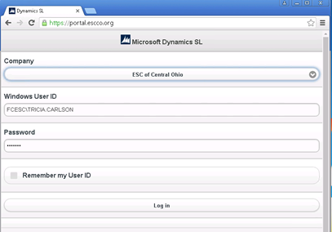
How to Log Into Solomon (cont.)

Slide 52
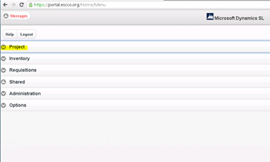
Select "Project" in the list of Applications

Slide 53
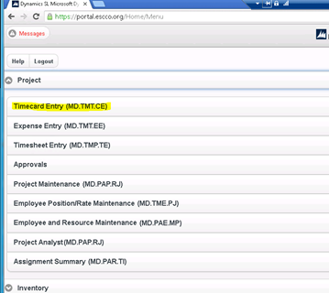
Select "Timecard Entry" in the list of Applications

Slide 54
How to Navigate through Web Apps
In the upper left hand corner of the screen there are three buttons:
The first one is to go back to the main menu
The second one is to go home
The final button is to cancel this timecard entry and start over

Slide 55
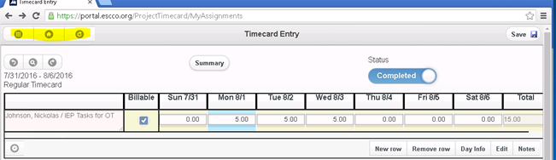
How to Navigate through Web Apps (cont.)

Slide 56
How to Navigate through Web Apps (cont.)
In the upper left hand corner of the timecard there are also three buttons:
The first one is to go back to the last timecard
The second one is to look up a timecard
The final button is to cancel this timecard entry and start over

Slide 57
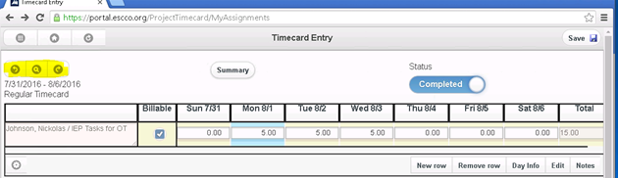
How to Navigate through Web Apps (cont.)

Slide 58
How to complete a timecard
Select "Current Entry" for your current timecard
If you are working on a timecard other than the current week, select the timecard from the "Open Timecard" option
All timecard end dates are on Saturday so you will need to be sure to select the correct week that is needed.

Slide 59
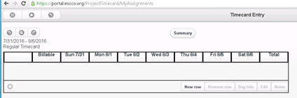
Select "New Row"to begin entering data on your timecard.

Slide 60
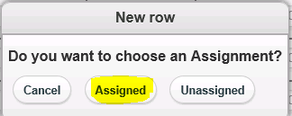
Then select "Assigned"

Slide 61
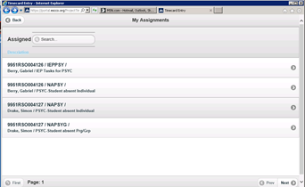
Select the Project

Slide 62
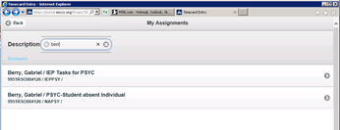
Type 4 or more letters of Student's Name in the Description Box and matching projects will appear below.

Slide 63
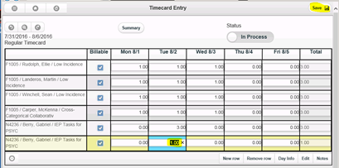
Select the day and enter the hours worked.

Slide 64
Select "Save"
After adding a new row, select "save"
Select "New row" to create another timecard line
To insure all of your lines are saved – save after each line is complete with time entered.
If needed, you can remove a line by highlighting the line and selecting "Remove row" (refer to next slide)

Slide 65
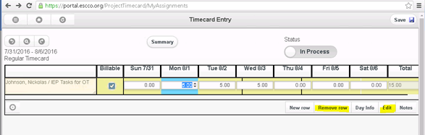
To Edit a line – Highlight the line and select "Edit"

Slide 66
Adding Comments to a timecard if needed
Press the Summary Button to add comments
Type your comments in the"Description" box
Select "Accept"

Slide 67
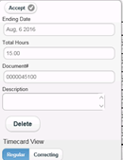
Adding Comments to a Timecard(cont.)

Slide 68
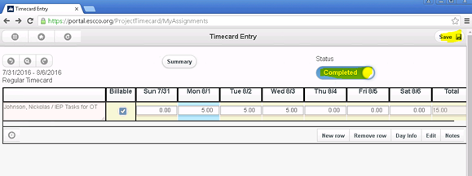
To submit your timecard select the status button and change it to"Completed"then select "Save".

Slide 69
Timecard Ready for Approval
Your timecard is now complete and ready to be approved.
Press the "Summary" button to get a recap of the total hours entered on this timecard if desired.
Press the "Summary"button to review the comments added to this timecard.

Slide 70
How to Duplicate a Timecard
To Duplicate a past timecard:
Go to "Project"
Select "Timecard Entry"

Slide 71
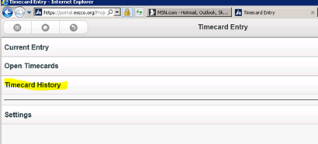
Select "Timecard History"

Slide 72
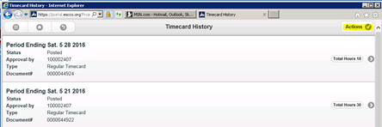
Click"Actions"

Slide 73
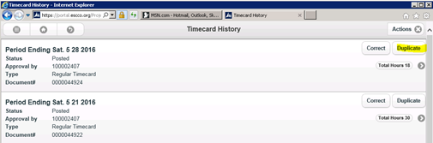
Click "Duplicate" next to the timecard you wish to duplicate.

Slide 74
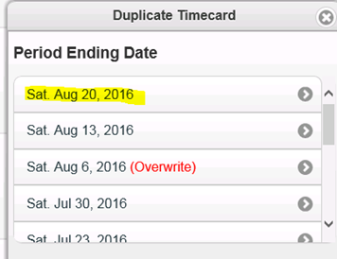
Pick the period to duplicate.

Slide 75
Duplicated Timecard will Appear
Your new timecard will appear with all of the projects from the duplicated timecard.
The hours are reset to zero.
Continue to add hours as needed.

Slide 76
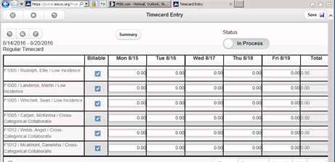
Example of a Duplicated Timecard

Slide 77
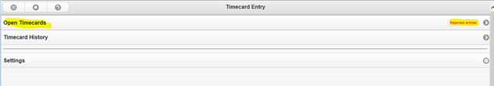
To Correct a Rejected Timecard – Select "Open Timecards"

Slide 78
To Correct a Rejected Timecard (cont.)
Scroll down to the timecard that has been rejected – Select it to open the timecard.
Make your changes, then change the status to "Complete" and save.
Your rejected timecard is now ready to be approved again.

Slide 79
Logging Out of Solomon
Log out by selecting the main menu icon in the upper left hand corner of the screen
The main menu icon is the 9 dot waffle button
Select "Logout"
Be sure that you have saved your data prior to logout
If you have not saved your data and choose to logout from the main menu icon, your data will be lost.

Slide 80
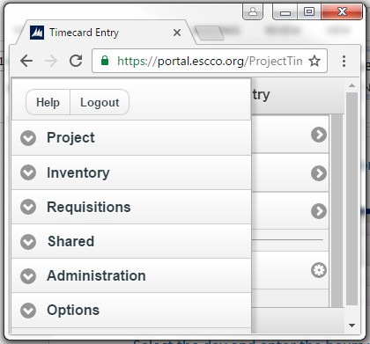
Logging Out of Solomon(cont.)

Slide 81
Helpful Tips
If you have any questions, red flags, or errors in your timecard contact your Approver/Chair.
If you have submitted a timesheet to your Approver/Chair with an error, contact him/her to reject it, so you can make corrections.
If you are absent on a Friday please submit your timecard from home if possible. If you cannot, please contact your Approver/Chair.

Slide 82
Why and When to Duplicate or Delete a Timecard
When to delete:
You have started, not yet saved a timecard for the wrong week
Once a timecard has been saved, it cannot be deleted
Why to duplicate:
So you don't have to enter all student names and tasks each time your submit a timecard
To minimize errors
What to duplicate:
Once a timecard has been completed, either your initial timecard or any completed timecard thereafter

Slide 83
When to Remove a Student from Your Timecard
  There are two reasons to remove a student:
    When a student is transferred to another class or service provider
    When a student has withdrawn from the program
  Timing for removal:
    The student must remain on the timecard through the last day that you provided services. The week after the last day services were received, the student can be removed from your timecard.

Slide 84
Reasons to use Solomon Helpdesk
Solomon.Help@escco.org
If you have any difficulty logging into Solomon.
If a student is supposed to be receiving related services, but there is no task assigned for your particular related service
If you have any questions about how to use the Solomon application

