Slide 1
Solomon Training for
Teachers
Revised September 2016

Slide 2
Processes and procedures
Solomon for the 2016-2017 School Year

Slide 3
Adding Newly Enrolled Students
If students need to be added to the timecard, please contact solomon.help@escco.org and carbon copy the Approver of your time card on the request.
Be sure to use the students name as it appears on their student record and to spell the student's name correctly on your request.

Slide 4
Topics For New and Returning Users
What is Solomon?
How will data in Solomon be used?
What data will get entered?
Solomon Glossary
Timecard Rules
Helpful Tips
Solomon Help

Slide 5
What is Solomon?
Solomon is a Microsoft software application that business can use to track financial and billing data and project information.
The ESC of Central Ohio is using this software to track program enrollment and related services provided to students.

Slide 6
How will data in Solomon be used?
This information will be used for two purposes:
  To verify that students are receiving the programs and services on their Individual Education Plans (IEPs) and
  To ensure that the data used to bill districts is as accurate as possible.

Slide 7
What data will get entered?
The ESC has a secure, on-line “portal” where staff will log-in to access the Solomon application.
All students are marked with a “1.0” for each day ENROLLED. Solomon is NOT intended to be used for tracking a students or staff’s attendance.
If school is closed for a Calamity Day the student is still considered enrolled for that day. HOWEVER, should that calamity day be made up in the future, DO NOT record enrollment for that day.

Slide 8
Solomon Glossary
Project – a student
Task – an program
Web Apps (portal) – where you log into Solomon on-line.
Timecard – where you enter the days the students is enrolled in your classroom.

Slide 9
Timecard Rules
A timecard must be created for all weeks during the school year.
  Winter Break and Spring Break timecards should be created before you leave for break and submitted with all 0’s. You must mark the timecard complete.
  All timecards must be submitted for approval:
    Every Friday no later than 5:00pm
    If any extenuating circumstances may prevent access to the internet, please contact Solomon.Help@escco.org as soon as you are aware of the issue.

Slide 10
How to enter data in Solomon
Solomon for the 2016-2017 School Year

Slide 11
What you’ll learn
How to log into Solomon
How to Navigate Web Apps
How to create an initial timecard
How to submit a timecard for approval
When to delete students from your timecard and how to do it
How to create subsequent timecards
When to delete a timecard and how to do it

Slide 12
How to Log Into Solomon (desktop, laptop, or phone)
Using the Google Chrome browser go to website: https://portal.escco.org
Log in using FCESC\Your network login
Enter your network password
Select "Remember my User ID" if you are using your office workstation.
You can either press enter or select the "Log in" button

Slide 13
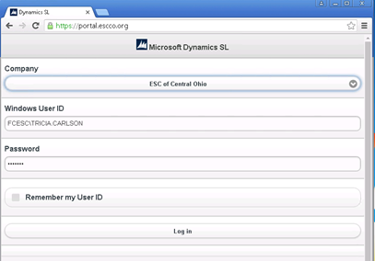
How to Log Into Solomon (cont.)

Slide 14
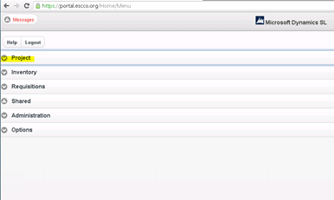
Select "Project" in the list of Applications

Slide 15
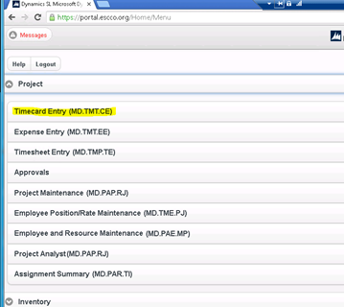
Select "Timecard Entry" in the list of Applications

Slide 16
How to Navigate through Web Apps
In the upper left hand corner of the screen there are three buttons:
The first one is to go back to the main menu
The second one is to go home
The final button is to cancel this timecard entry and start over

Slide 17
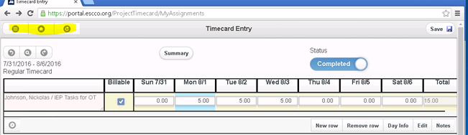
How to Navigate through Web Apps (cont.)

Slide 18
How to Navigate through Web Apps (cont.)
In the upper left hand corner of the timecard there are also three buttons:
The first one is to go back to the last timecard
The second one is to look up a timecard
The final button is to cancel this timecard entry and start over

Slide 19
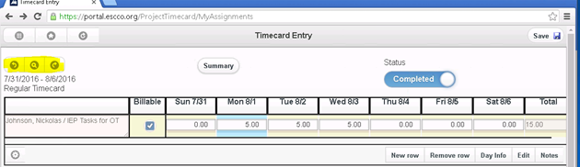
How to Navigate through Web Apps (cont.)

Slide 20
How to complete a timecard
Select "Current Entry" for your current timecard
If you are working on a timecard other than the current week, select the timecard from the "Open Timecard" option
All timecard end dates are on Saturday so you will need to be sure to select the correct week that is needed.

Slide 21
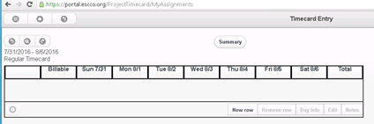
Select "New Row"to begin entering data on your timecard.

Slide 22
Program Task Codes
For each of your students please only select the task code related to your classroom type:
ACT = TRACC ED = Emotional Disturbed FULL DAY
CBT = Campus Based Transition ED2 = Emotional Disturbed QTR DAY
CCMD = Low Incidence ED3 = Emotional Disturbed HALF DAY
CRSCRK = Cross Creek HI = Hearing Impaired FULL DAY
HI2 = Hearing Impaired QUARTER DAY
HI3 = Hearing Impaired HALF DAY
STACK = Structured Teaching for Autistic and Communication-delayed Kids
If your student is missing the appropriate task code please STOP and email Solomon.Help@escco.org. DO NOT CONTINUE entering data for that student.

Slide 23
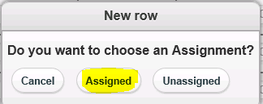
Then select "Assigned"

Slide 24
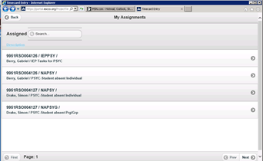
Select the Project

Slide 25
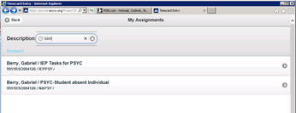
Type 4 or more letters of Student's Name in the Description Box and matching projects will appear below.

Slide 26
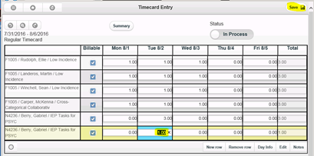
Select the day and enter the student’s enrollment status (either 1 for enrolled or 0 for not enrolled).

Slide 27
Select "Save"
After adding a new row, select "save"
Select "New row" to create another timecard line
To insure all of your lines are saved – save after each line is complete with time entered.
If needed, you can remove a line by highlighting the line and selecting "Remove row" (refer to next slide)

Slide 28
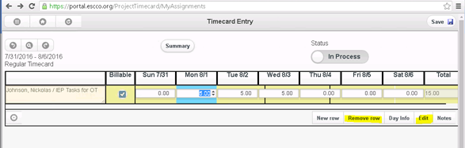
To Edit a line – Highlight the line and select "Edit"

Slide 29
Adding Comments to a timecard if needed
Press the Summary Button to add comments
Type your comments in the"Description" box
Select "Accept"

Slide 30
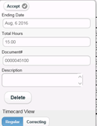
Adding Comments to a Timecard(cont.)

Slide 31
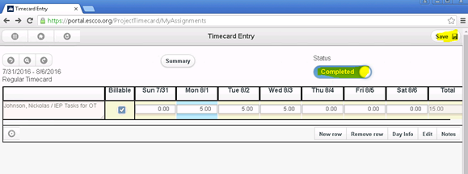
To submit your timecard select the status button and change it to"Completed"then select "Save".

Slide 32
Timecard Ready for Approval
Your timecard is now complete and ready to be approved.
Press the "Summary" button to get a recap of the total hours entered on this timecard if desired.
Press the "Summary"button to review the comments added to this timecard.

Slide 33
How to Duplicate a Timecard
To Duplicate a past timecard:
Go to "Project"
Select "Timecard Entry"

Slide 34
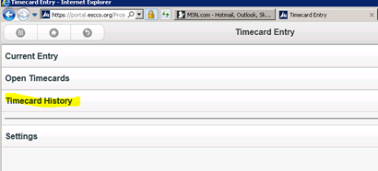
Select "Timecard History"

Slide 35
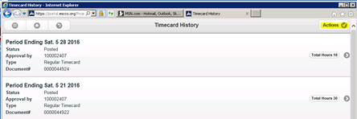
Click"Actions"

Slide 36
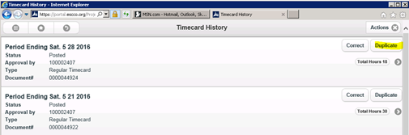
Click "Duplicate" next to the timecard you wish to duplicate.

Slide 37
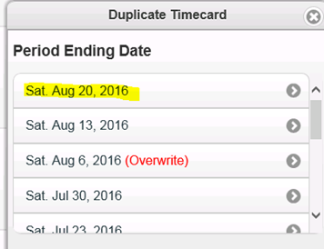
Pick the period to duplicate.

Slide 38
Duplicated Timecard will Appear
Your new timecard will appear with all of the projects from the duplicated timecard.
The hours are reset to zero.
Continue to add hours as needed.

Slide 39
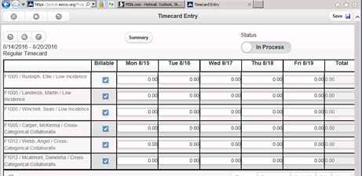
Example of a Duplicated Timecard

Slide 40
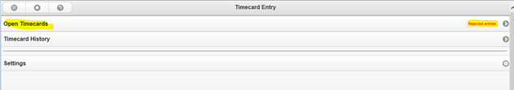
To Correct a Rejected Timecard – Select "Open Timecards"

Slide 41
To Correct a Rejected Timecard (cont.)
Scroll down to the timecard that has been rejected – Select it to open the timecard.
Make your changes, then change the status to "Complete" and save.
Your rejected timecard is now ready to be approved again.

Slide 42
Logging Out of Solomon
Log out by selecting the main menu icon in the upper left hand corner of the screen
The main menu icon is the 9 dot waffle button
Select "Logout"
Be sure that you have saved your data prior to logout
If you have not saved your data and choose to logout from the main menu icon, your data will be lost.

Slide 43
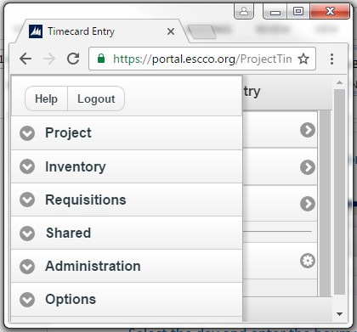
Logging Out of Solomon(cont.)

Slide 44
Helpful Tips
If you have any questions, red flags, or errors in your timecard contact your Approver.
If you have submitted a timesheet to your Approver with an error, contact them to reject it, so you can make corrections.
If you are absent on a Friday please submit your timecard from home if possible. If you cannot, please contact your Approver.

Slide 45
Why and When to Duplicate or Delete a Timecard
When to delete:
You have started (not yet saved) a timecard in the wrong week. Once a timecard has been saved, it can not be deleted.
Why to duplicate:
So you don't have to enter all student names and tasks each time your submit a timecard.
To minimize errors
What to duplicate:
Once a timecard has been completed, either your initial time card or any completed timecard thereafter.

Slide 46
When to Remove a Student from Your Timecard
  There are two reasons to remove a student:
    When a student is transferred to another class or service provider
    When a student has withdrawn from the program
  Timing for removal:
    The student must remain on the timecard through the last day that you provided services. The week after the last day services were received, the student can be removed from your timecard.

Slide 47
Reasons to use Solomon Helpdesk
Solomon.Help@escco.org
If you have any difficulty logging into Solomon.
If a student is enrolled in your class and not showing up as “Assigned” to you
If you have any questions about how to use the Solomon application

