Slide 1

Area 11
(Franklin County)
Pre-Apprenticeship Hub

Slide 2
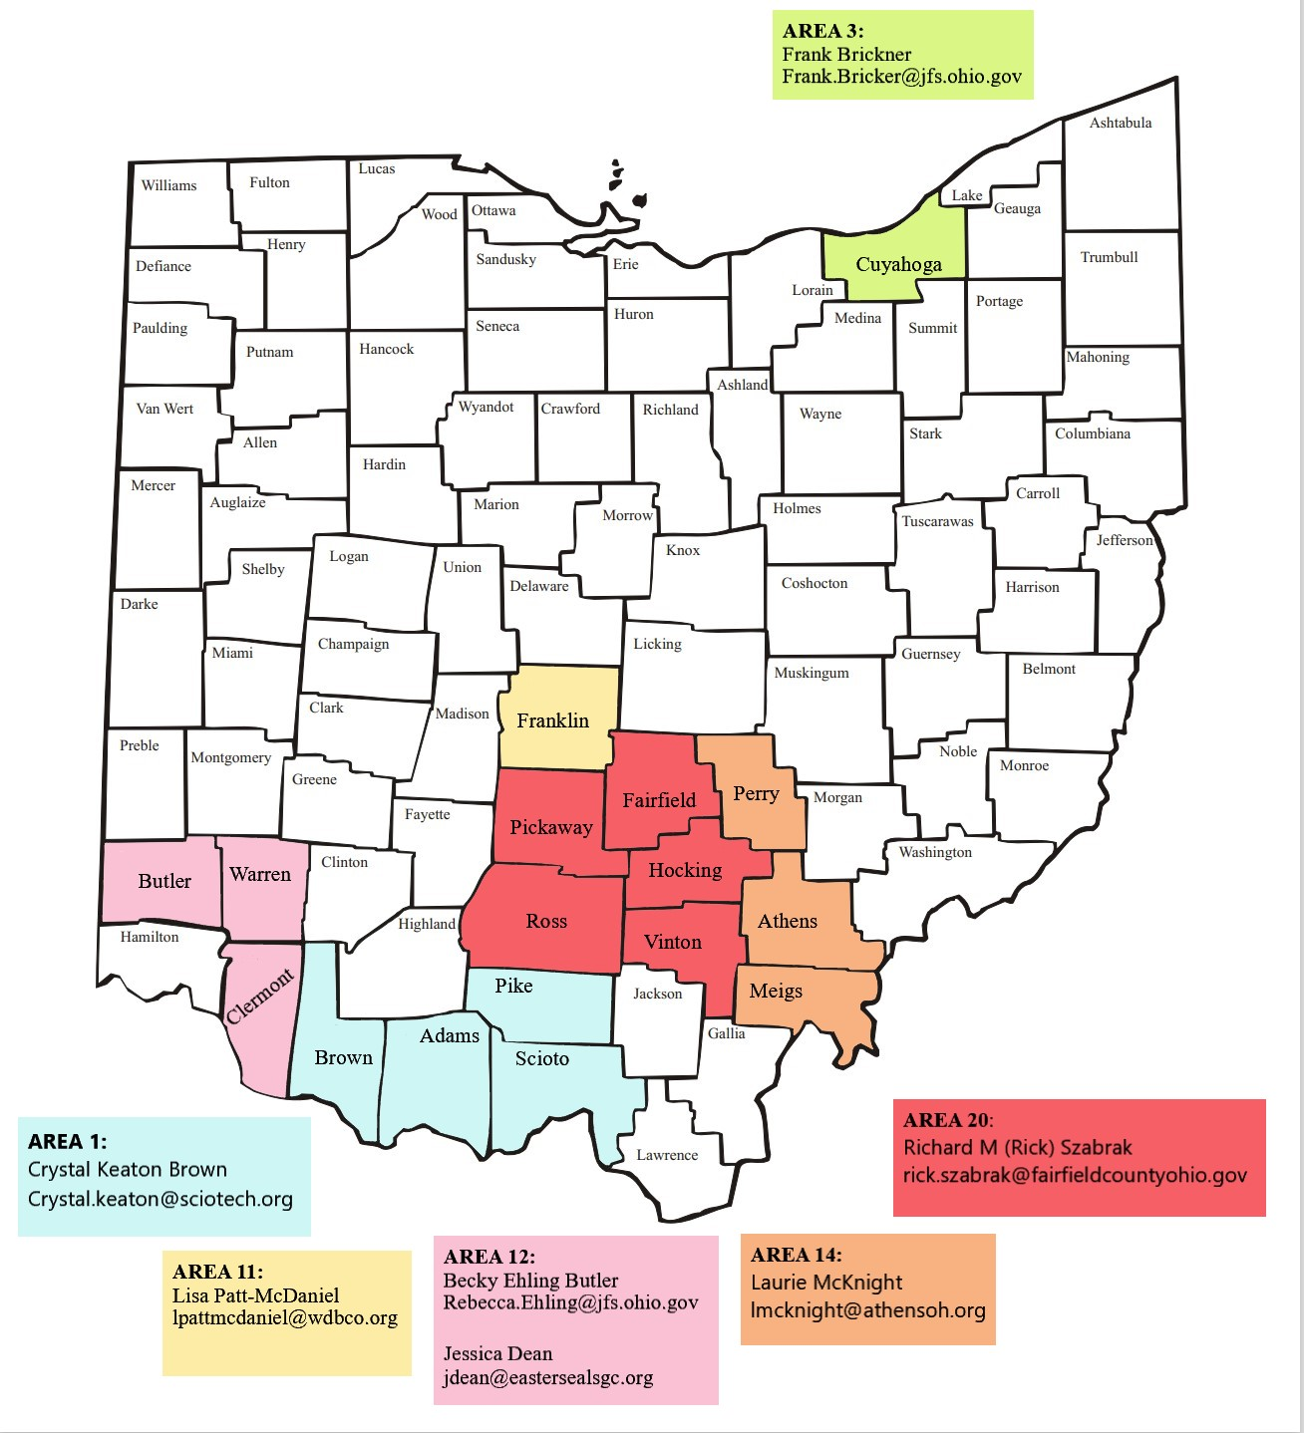
Statewide Pre-Apprenticeship Hubs

Slide 3
Pre-Apprenticeship “Hub” Goals
Operate out of the Ohio Means Jobs Columbus- Franklin County Center and fully partner with existing programs
Increase staffing and funding to aid in program improvement and development resulting in a sustainable, growing system
Identify strategies that enrich current practices
Expand programming in Healthcare, Digital Careers, and Manufacturing
Multiply and Strengthen relationships with Sponsors and Employers
Create new programs in both K-12 and adult/community- based settings
Create a Gateway for pre-apprentices to transition into Registered Apprenticeship Employment
Enhance workforce diversity and inclusion by prioritizing recruitment of under-represented populations and individuals with barriers to employment

Slide 4
Contact information
Kelly Wallace
kwallace@wdbco.org
740-973-9461

