Slide 1



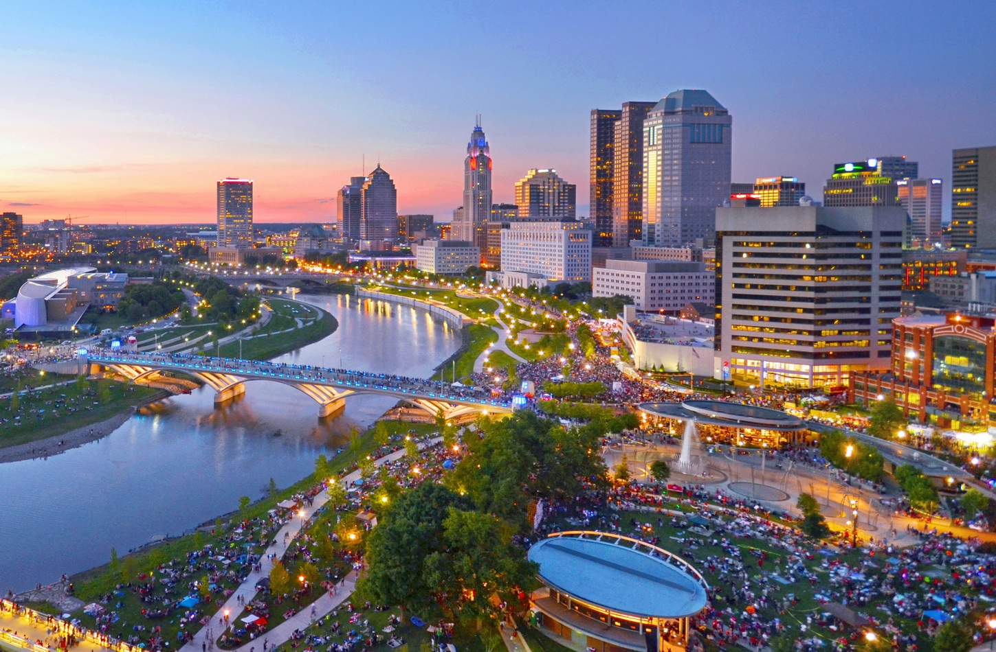


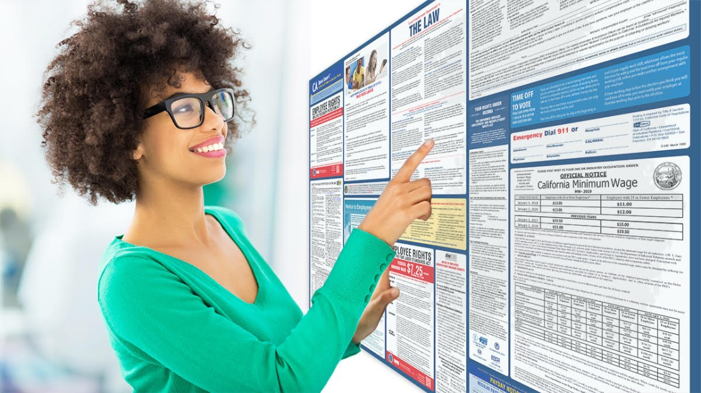


WORKFORCE EQUITY REPORT: 2021 COLUMBUS REGION - JOBS & OPPORTUNITY
Tim Harman, Sr. Consultant
TKHarman@yahoo.com

Slide 2
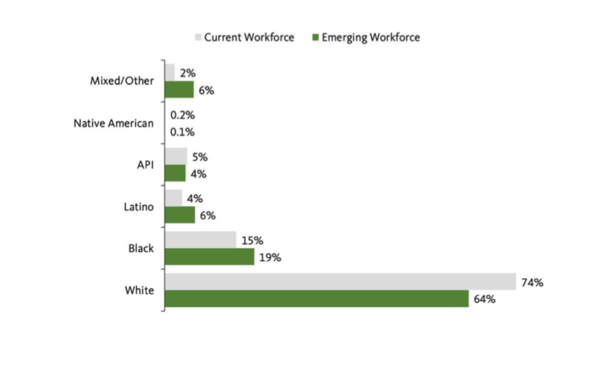
The Columbus Region workforce is steadily becoming more diverse.
Current and Emerging Workforce Demographics by Race/Ethnicity, Columbus metropolitan region, 2018

Slide 3
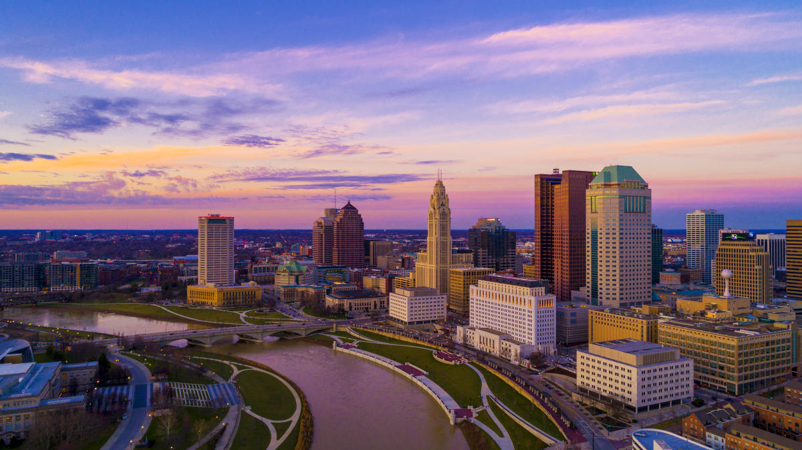







Columbus is characterized by the “Columbus Way,” which describes the close collaboration between business, city and regional leaders, and the academic and nonprofit community.
WorkforceInnovationCenter
@WorkforceLeader

Slide 4
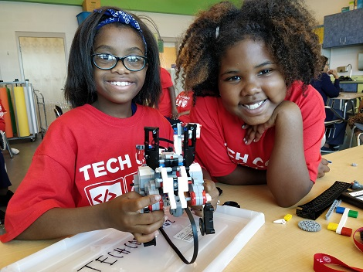
OVERVIEW
BACKSTORY OF THE REPORT
  Black, Hispanic inequity across Columbus Region workforce
WHAT’S HAPPENING…
  Driver of Workforce Inequity
  Data through refreshed lens
  Pandemic Impact/Workforce Trends
WHAT TO EXPECT
  Middle Wage Job Growth
  Challenges for Employers + Community
@WorkforceLeader

Slide 5

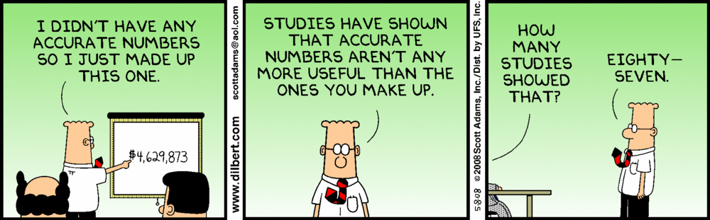
DATA SOURCE
  2018 5-year American Community Survey (ACS) microdata from IPUMS USA
  A proprietary occupation-level dataset from Burning Glass Technologies expressed at the six-digit Standard Occupational Classification (SOC) level
Matt Walsh, Burning Glass Technologies
Matthew.Walsh@Emsibg.com
@WorkforceLeader

Slide 6
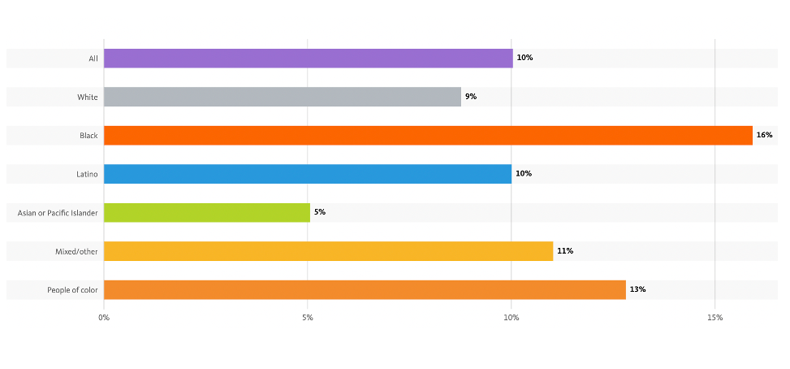
Percent of 16-24 year olds not in school or working by race/ethnicity, Columbus Region 2017

Slide 7

Racism drives workforce inequities.
The racial gaps in economic outcomes experienced by workers and families in the Columbus Region arise from a complex set of historical and ongoing social and policy causes.
Inequitable investments and access to quality education
Rapid growth: housing & transit challenges
Lack of affordable supports
Residential segregation
Occupational segregation
Bias and discrimination

Slide 8
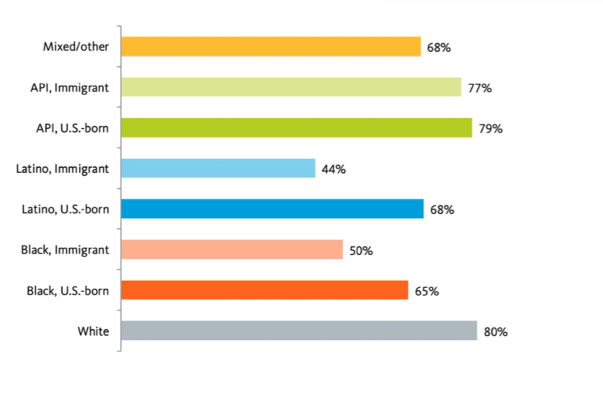
80% of White workers earn at least $15/hr compared to 50% of Black immigrant and 44% of LatinX Immigrant workers.
Share of Workers Earning at Least $15/hour by Race/Ethnicity and Nativity, Columbus Region, 2018

Slide 9
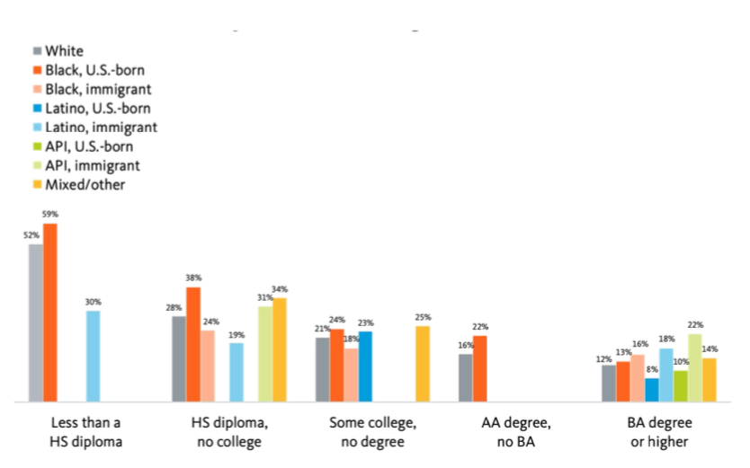
Higher educational attainment narrows racial gaps in employment, however black workers without a bachelor’s degree still face increased rates of joblessness,
Joblessness by Educational Attainment, Race/Ethnicity, and Nativity, Columbus metropolitan region, 2018

Slide 10
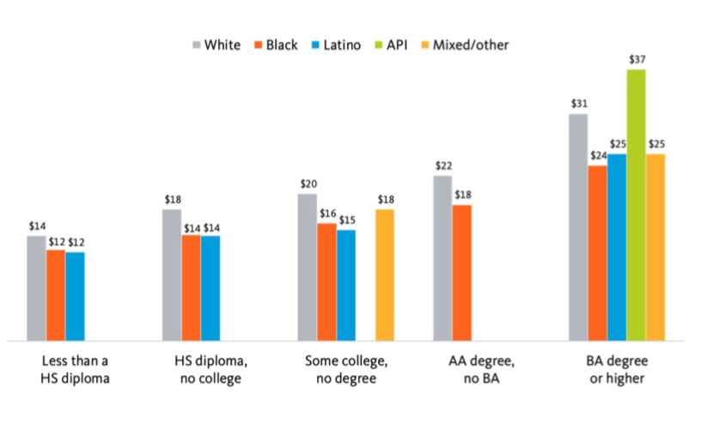
… and widening wage gaps.
Median Wages by Educational Attainment and Race/Ethnicity, Columbus metropolitan region, 2018

Slide 11
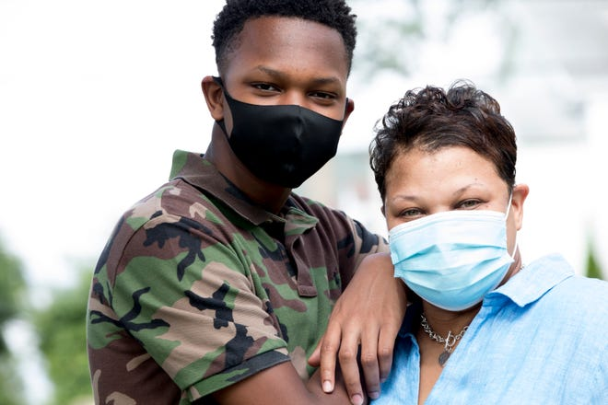
PANDEMIC IMPACT
Ohio lost 23,021 lives to Covid, April 2020-September 2021
Ohio lost 650,000 jobs in 2020
  Retail, Restaurant, Hospitality, Entertainment, Travel Industries were hardest hit.
  Some of these jobs/employers will never return…
Essential Workers were defined
  Health Care, Grocery Stores, Logistics/Delivery...Many in low paying - Middle wage roles.
Racial Equity access gaps were accelerated

Slide 12
UNEMPLOYMENT RATE , COLUMBUS JANUARY 2020 – MARCH 2021
Source: Authors’ analysis of Burning Glass job posting data (January–September 2020), with job postings allocated according to occupational race and ethnicity characteristics from 2018 5-year American Community Survey (ACS) microdata from IPUMS USA.

Slide 13
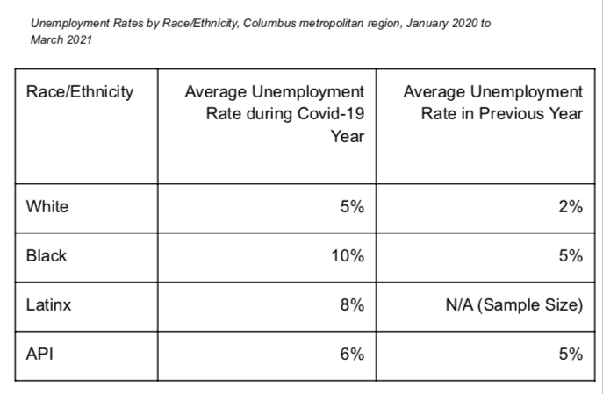
Unemployment rates doubled during the pandemic from previous year.
Unemployment Rates by Race/Ethnicity, Columbus metropolitan region, January 2020 to March 2021

Slide 14
LABOR PARTICIPATION RATE, COLUMBUS JANUARY 2020– MARCH 2021
Source: Authors’ analysis of Burning Glass job posting data (January–September 2020), with job postings allocated according to occupational race and ethnicity characteristics from 2018 5-year American Community Survey (ACS) microdata from IPUMS USA.

Slide 15
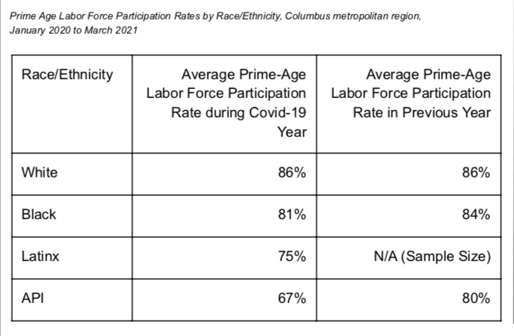
Labor Force participation rates varied during the pandemic. “W” Effect
Unemployment Rates by Race/Ethnicity, Columbus metropolitan region, January 2020 to March 2021

Slide 16
The Columbus Region workforce is steadily becoming more diverse.
Current (2015-2018) Emerging (2020-2030) Workforce Demographics by Race/Ethnicity, Columbus Region, 2018

Slide 17


“PANDEMIC”
WORKFORCE TRENDS
Columbus unemployment peaked in May-June 2020 for Whites….?
Columbus Labor Participation highest in June 2020 for Blacks….?
Columbus unemployment peaked in August-Sept 2020 for Blacks…?
Columbus Labor Participation highest in January 2021 for Whites…?
Columbus’ Asian Population is shrinking….specifically amongst our Asian Immigrants with a B.A. degree…?
Are we losing our role as a secondary/landing city for immigrants and becoming a springboard city?

Slide 18

WHAT TO EXPECT
MIDDLE WAGE JOB GROWTH WILL CONTINUE...........NOT EQUITABLE
AVERAGE WAGE INCREASES ARE SLUGGISH WHILE PRICES OF CONSUMER GOODS ARE SPIKING
LABOR PARTICIPATION RATE ”W” EFFECT WILL CONTINUE
@WorkforceLeader

Slide 19
Number of Workers in Good Jobs by Race/Ethnicity and Educational Requirements, Columbus metropolitan area, 2018
588,914
420,930
Source: Employment from 2018 5-year American Community Survey microdata from IPUMS USA, and occupational characteristics from Burning Glass job posting data and 2018 5-year American Community Survey microdata from IPUMS USA

Slide 20

WHAT’S A GOOD JOB
Characteristics of good jobs:
Living wage compensation: Average wage for the occupation is sufficient to sustain a working family of two working adults and two children.
  $32,718 in Columbus
Stable or growing base of employment: The number of jobs is projected to grow or to remain relatively stable for the next decade -- employment in the occupation is not declining by more than 10 percent over 10 years, or more than than 2 percent over 10 years for small occupations
Automation resilient: The occupation has a probability of computerization lower than 50 percent, given the full array of tasks that comprise the role
MIT Living Wage Calculator, https://livingwage.mit.edu/, accessed January 2021
@WorkforceLeader

Slide 21
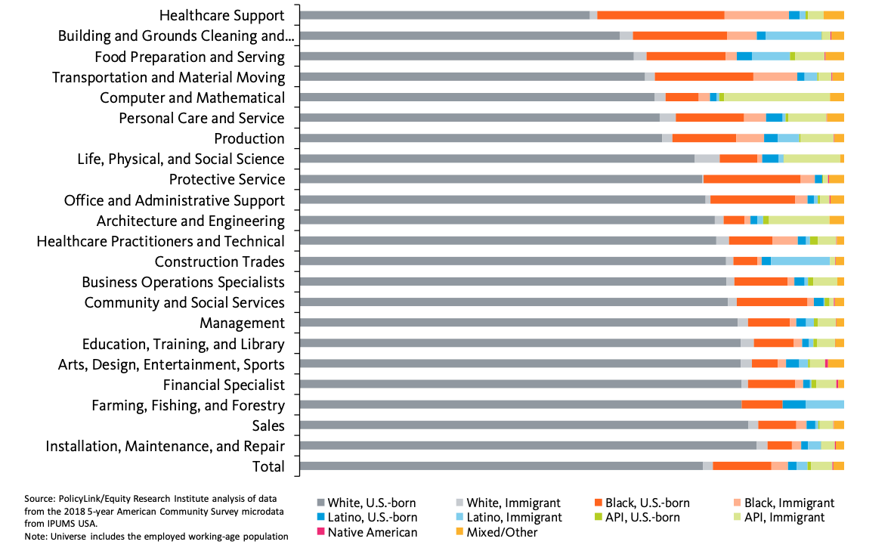

OCCUPATIONAL REPRESENTATION

Slide 22
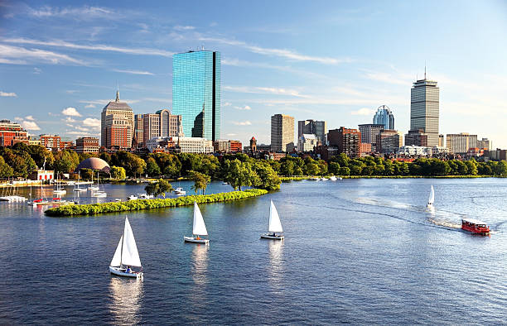
WHAT ARE OTHER CITIES DOING?
DALLAS – Focus on Apprenticeships and pathways for people of color into the apprenticeships. Which industries is TBD
BAY AREA (San Francisco, Oakland) – Creating “Worker’s Bill of Rights” , Addressing Policy change and enactment.
BOSTON – Eds & Meds focus on Educational (teachers) and Medical Field pathways.
CHICAGO – Advocate for Policy change and initiatives
@WorkforceLeader

Slide 23

RECOMMENDATIONS
COLUMBUS REGION
The spirit which launched the Columbus Way must be intentionally shifted to advance workforce equity.
Build trust in workforce development by bringing workers, residents, families, and neighborhoods into workforce development strategy, setting race-forward goals for the workforce development system, and unifying economic development and workforce development.
Lean into regional partnerships to break silos in workforce development.
Bring jobs to the people and people to the jobs.
Engage employers to adopt best practices in hiring, retaining, and promoting workers of color.
Dramatically expand apprenticeships, and target people of color for these programs.
Cater services to immigrant and English as a second language populations.
Expand on career pathways that start with entry-level positions in target sectors with good employment prospects.
@WorkforceLeader

Slide 24


THANK YOU!
Tim Harman
TkHarman@yahoo.com
“If you could only sense how important you are to the lives of those you meet… There is something of yourself that you leave at every meeting with another person.”
Fred Rogers
@WorkforceLeader

