Slide 1
YOUNG ENTREPRENEURS PROGRAM
Learn something. Do something. Be something.
Meaningful.

Slide 2
YEP - What and Why?
Goal
A community of talented young entrepreneurs who will significantly contribute to economic growth.
Strategy
Provide young talent in Columbus with opportunities to develop skills, explore interests and expand their potential to grow into entrepreneurs.

Slide 3
YEP – How?
Tactics
Internship w/ Columbus’ most entrepreneurial companies
Access/connections to w/ CEOs and executive teams
Ongoing education and support from YEP
Networking and development w/ YEP members.

Slide 4
PHASES IN STUDENT LIFE
Junior Year High School – Develop interest in specific areas
Senior Year High School – Determine educational goals
College/ Undergraduate Programs – Pursue Interest, Gain Knowledge
Take up a job/ Master’s Degree – Move ahead in area of interest
College/ Undergraduate Summers – Take up job opportunities made available through college

Slide 5
PHASES IN YEP STUDENT LIFE
Junior Year High School – Develop interest in specific areas
Post Junior Year /Senior Summer – Begin skill-development and training in area of interest through YEP
Senior Year High School – Determine educational goals with higher certainty
Take up a job/ Master’s Degree – Move ahead in area of interest, work with YEP network for reverse migration opportunities in Columbus
College/ Undergraduate Summer – Stay in touch with YEP mentors, higher awareness of opportunities in Columbus
College/ Undergraduate Programs – Pursue Interest, Gain Knowledge

Slide 6
INDUSTRY INTERNSHIP OPPORTUNITIES
Function - Marketing
  Performing Market Research
  Improving Social Media Presence
  Web Design
  Assisting on a Marketing Campaign
Function - Sales
  Sales Process Documentation
  Telesales
  Assisting on a Sales Campaign
Function – Product Management
  Building a New Product Feature
  Documenting Product Process Flow
  Assisting on a Product Testing Cycle

Slide 7
INDUSTRY INTERNSHIP OPPORTUNITIES
Function - Engineering
  Building a feature
  Fixing long-standing technical issues
Function - Finance
  Analyzing profitability of a small project
  Assisting on cost management for a project
Function – HR
  Assisting on an HR process such as Onboarding
  HR Process Documentation

Slide 8































UNIVERSITIES OUR ALUMNI ARE ATTENDING

Slide 9











BUSINESS PARTNERS

Slide 10
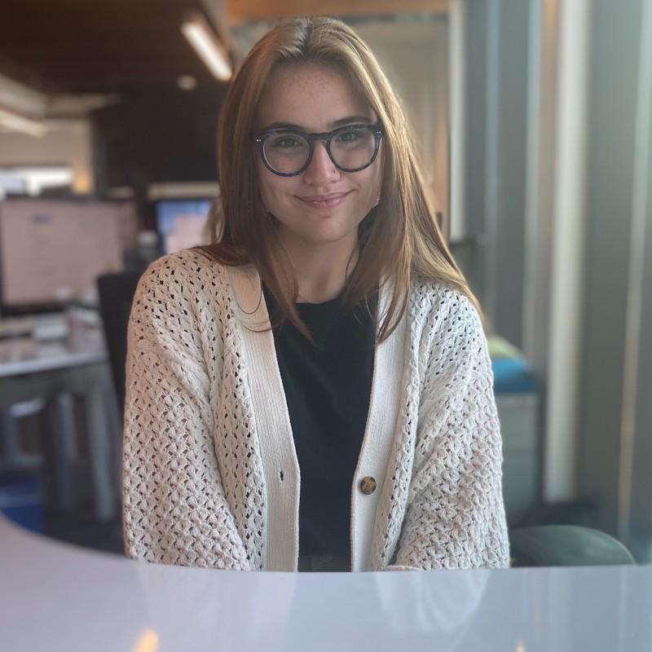
INTERN EXPERIENCES – Aaliyah Barker
When I initially heard of YEP, I was excited about the real-world experience it offered, which was not achievable in the classroom. Through YEP, I secured an internship at Drive Capital, a venture capital firm in Columbus, Ohio. I came into the space with a sense of imposter syndrome. “I am just an intern. I do not deserve to be around such successful people.” Through Jesus and my mentors at Drive, I was able to step outside of my comfort zone and explore the world startups. I left the space with sense of purpose and confidence, which has allowed me to continue my journey in the business world through an internship at Tandem, one of Drive’s portfolio companies. I never thought I would be interested in anything STEM related but exploring hundreds of startups at Drive opened me up to a whole new world of possibilities. I am now working on developing a browser extension that combats the sustainability of fast fashion with a former mentor from Drive Capital. I am currently working as the full-time marketer at Tandem, while also completing an Associate’s Degree in Business.
- Aaliyah Barker, YEPKC 2021

Slide 11
CONTACT INFORMATION
EMAIL: JFUENTES@YEPKC.ORG
        Please add to your email contact list to prevent my emails from being caught by school district firewalls.
PHONE: (816) 808-6764
Feel free to shoot me a private zoom chat message with your phone number and EXT. I’ll happily call you on Friday so we can set up a time to chat further.
WEBSITE: YEPROGRAM.ORG

